Slide 1
DO NOW DO NOW DO NOW Get YOUR BLACK PORTFOLIO
Choose 1 Fairy Tales from the board. Write and describe 3 exciting moments that were used in these stories that created such a memorable fairy tale!
Cinderella, Snow White, Shrek, Frozen, Sleepy Beauty, The Little Mermaid, Paul Bunyan, The Three Little Pigs, Aladdin, Peter Pan, Beauty and the Beast, etc…

Slide 2
The vital story elements
Defined, detailed Characters
Established setting
Strong, clear character objectives
Compelling conflict

Slide 3
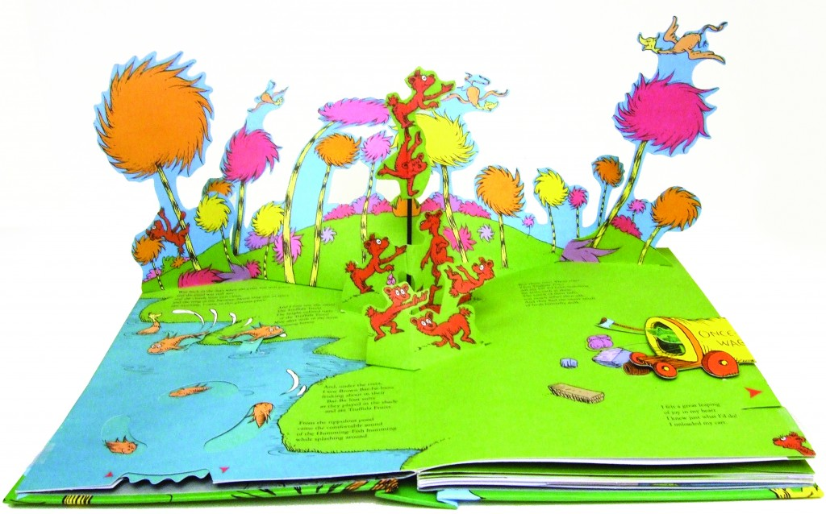
Pop-Up Story
Review the two videos and what are the storytelling elements are IMPROVed into the scene!
https://www.youtube.com/watch?v=utQKcZi9vZM
https://www.youtube.com/watch?v=oXvRJ290QAg

Slide 4
Did the fairy tale have the vital elements?
Defined, detailed Characters?
Established setting?
Strong, clear character objectives?
Compelling conflict?

Slide 5
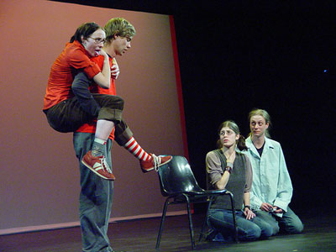
Fairy Tale “Pop Up” Creations
Step 1 (Group Work): Discuss what story you will perform and write it for your group. Discuss what your vital story elements will be!
Step 2 (Instruction): Cast your stories. (create your characters) Rehearse your stories with one another.
Step 3 (Group Practice): Groups have ten to fifteen minutes to practice their outlined stories.
Step 4 (Assessment):
Perform your POP UP stories for the class!
Step 5 (Reflection): What the strengths and weaknesses of the story? Were all of the elements of storytelling observed?

Slide 6
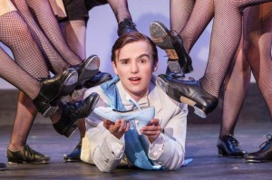
MODERNIZE IT!
CHANGE THE SETTING!
Cinderella’s Castle Ball == High School Prom Celebration
CHANGE THE CHARACTERS!
The Seven Dwarves == The Seven Mean Girls
CHANGE THE SITUATION!
Cinderella loses her glass slipper == Cinderella loses her Magic Beats Headphones

Slide 7
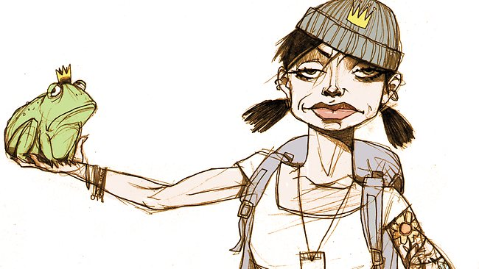
Improv Group Work
Choose a group of 3 people!
Students will create a scene using the key moments and ideas of that fairy tale, but set in a modern time.
Each scene should follow the original fairy tale, but with your new STYLE!
Each scene should be at least 5 minutes!

