Slide 1
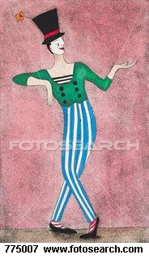
Pantomime
The word "pantomime" originates from the Greek words pan and mimos, "all imitating". Performances of pantomime in Ancient Greece were a popular form of entertainment that typified comedies and tragedies. In Roman civilization, pantomime was performed as part of regular theater.
To accompany Text
pp.28-29, 402-3
and teacher notes

Slide 2
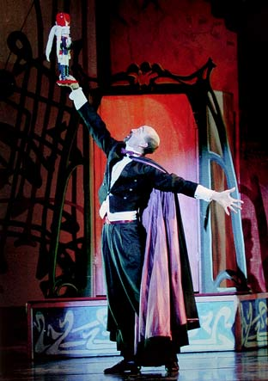
Pantomime in the Renaissance
In 15th century Italy, as ballet grew in popularity, pantomime added dimension to characters like the villains in Swan Lake or Nutcracker Suite.
Also, scripts written by ancient poets were readapted as stories portrayed by mimes.
From the 16th through the 18th centuries, pantomime spread throughout France and England as entertainment during intermissions of operatic performances.

Slide 3

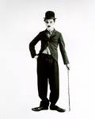
Silent Film Stars
Charles Chaplin, in the early part of the 19th century created characters like "The Tramp" in silent films.
Silent films relied heavily on the ability of the actor to project facial expressions and exaggerated gestures that communicated ideas and themes in each film.
Other famous silent films stars are Buster Keaton, Laurel and Hardy, and Harry Langdon.

Slide 4

Marcel Marceau
1923-2007
Marceau was born in Strasburg, France. He imitated silent screen artists.
Marceau's most famous pantomimes include, "The Mask Maker", "Walking Against The Wind" and a summation of aging man.
Marceau is considered the icon of pantomime in the world of entertainment.
http://www.youtube.com/watch?v=_lF0XMCssG0

Slide 5
Pantomime Today
Today pantomime, is often seen as a mix of movement and visual art, using props, masks, body movement, and light and shadow to create unusual shapes on stage that dazzle the imagination.
Mime has come a long way from the ancient Greek comedy and tragedy pantomimes and remains an important form of expression and movement in the theatrical world. Today, pantomime is taught as part of dance and drama training.

Slide 6
New Pantomime Artists
Mummenshanz is a new type of pantomime group started in the 1970’s that combines pantomime techniques to create unique performance art.
http://www.youtube.com/watch?v=cjZb5Y-yci4

Slide 7
The Blue Man Group
The Blue Man Group is centered on a trio of mute performers, called Blue Men, who present themselves in blue grease paint and wear latex bald caps and black clothing. Blue Man Group's theatrical acts incorporate rock music (with an emphasis on percussion), odd props, audience participation, sophisticated lighting, and large amounts of paper.
http://www.youtube.com/watch?v=LOL8-qIYemg

Slide 8

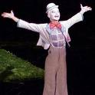
Cirque du Soleil
From a group of 20 street performers at its beginnings in 1984, Cirque du Soleil is now a major Quebec-based performance organization.
The company has more than 4,000 employees from over 40 different countries.
Cirque du Soleil’s mission is to invoke the imagination, senses and emotions of people around the world.

Slide 9
Pantomime -
Acting without Words
Movement used can be expressive facial expressions or gestures to:
Tell something significant about a character
Tell a story
Portray an activity without using real objects

Slide 10
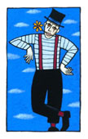
Vocabulary Words
Pantomime/Mime
Facial expressions
Gestures
Body movement
Balance
Imagination
Resistance

Slide 11
PANTOMIME/MIME
The art of physical acting

Slide 12
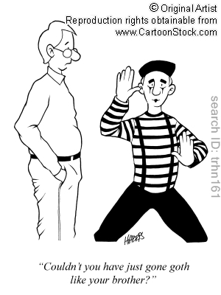

Slide 13
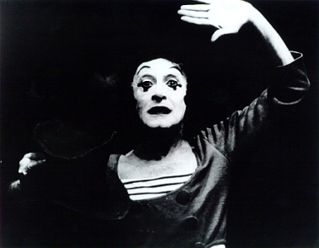
PANTOMIME/MIME
A mime artist (from Greek "μίμος"—mimos, "imitator, actor")
is someone who uses mime as a theatrical medium or as a performance art, involving miming, or the acting out a story through body motions, without use of speech.
In earlier times, in English, such a performer was referred to as a mummer.
Miming is to be distinguished from silent comedy, in which the artist is a seamless character in a film or sketch.
http://www.obit-mag.com/articles/master-mime
μίμος, Henry George Liddell, Robert Scott, A Greek-English Lexicon, on Perseus Digital Library

Slide 14
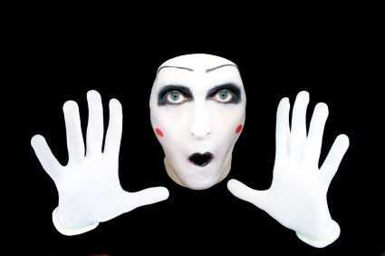
PANTOMIME/MIME
Mime is one of the oldest forms of theatre - the dramatic art of representing scenes from life through expressive bodily and facial movements.
Originates at its earliest in Ancient Greece; the name is taken from a single masked dancer called Pantomimus
"Pantomime" is all-in-mimic, and usually refers to the mimed dramatic sketch as a whole.
http://tarang.iiitdmj.ac.in/nishabd.php
http://www.mimelikethis.com/theart.htm

Slide 15
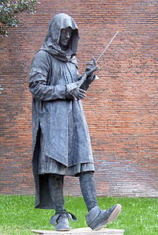
PANTOMIME/MIME
Paris, Jean-Gaspard Deburau solidified the many attributes that we have come to know in modern times—the silent figure in whiteface
Pantomime and mime played an important role in films prior to advent of “talkies”
http://en.wikipedia.org/wiki/Mime_artist
μίμος, Henry George Liddell, Robert Scott, A Greek-English Lexicon, on Perseus Digital Library

Slide 16
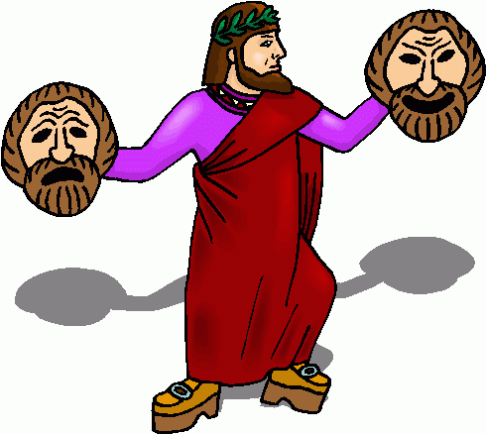
HISTORICAL
PRECEDENTS
WESTERN EUROPE
pic2fly.com

Slide 17
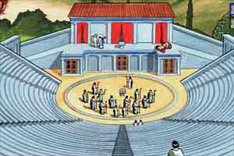
ANCIENT WORLD
Pantomime in Greece, also called "the art of interpretive dancing," often took the form of mimetic dances, or military pantomimes such as Pyrrhic dances.
The art of gesture was called orchesis, from which we get the word orchestra, the Greek term for a dancing place
The Romans were especially fond of pantomime, mounting subjects from myth and legend in movement, sometimes accompanied by narration or song
http://www.jeron.je/anglia/learn/pri/history/greeks/page25.htm
MimeLikeThis.com by Bari Rolfe Edited by Cary Trivanovich with Bari Rolfe

Slide 18
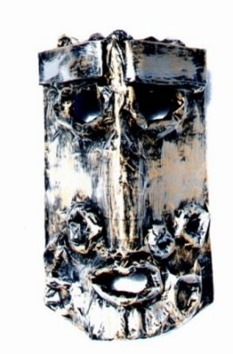
MEDIEVAL EUROPE
When Rome fell, the theatres were closed and entertainers were reduced to wandering through the countryside, playing at fairs and markets
The Church banned them for being licentious and cruel
Tableaux vivants consisted of a single representative pose, or a series of sculptural poses illustrating a story
http://www.the-shadows-dimension.com/mask.htm
MimeLikeThis.com by Bari Rolfe Edited by Cary Trivanovich with Bari Rolfe

Slide 19
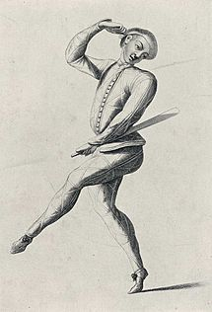
COMMEDIA DELL’ARTE
Commedia dell'arte is a spoken form of theatre derived from rustic farce.
It is of interest to mimes because it was a highly physical theatre form utilizing mime, gymnastics, and silent by-play.
Commedia dell'arte lasted for over 200 years as an art form.
http://en.wikipedia.org/wiki/File:Richarlequin.jpg
MimeLikeThis.com by Bari Rolfe Edited by Cary Trivanovich with Bari Rolfe

Slide 20
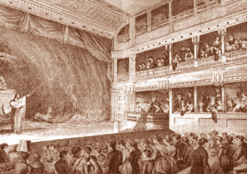
DUMBSHOW
A traditional term for pantomime in drama, actions presented by actors onstage without spoken dialogue.
An interlude of silent pantomime usually with allegorical content that refers to the occasion of a play or its theme
The term is most often used in regard to medieval drama and English Renaissance theatre.
mimelikethis.com
Shipley, Joseph T. Dictionary of World Literary Terms: Criticism, Forms, Technique. London, Allen & Unwin, 1955.

Slide 21
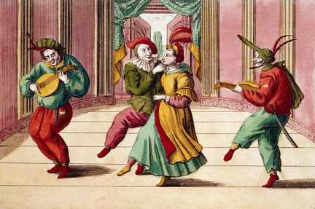
MASQUE
A form of festive courtly entertainment which flourished in 16th and early 17th century Europe, though it was developed earlier in Italy.
Masques were typically a complimentary offering to the prince among his guests and might combine pastoral settings, mythological fable, and the dramatic elements of ethical debate.
There would invariably be some political and social application of the allegory.
venetianmasquerademasks.co.uk
David Bevington and Peter Holbrook, editors, The Politics of the Stuart Court Masque 1998 ISBN 0-521-59436-7).

Slide 22
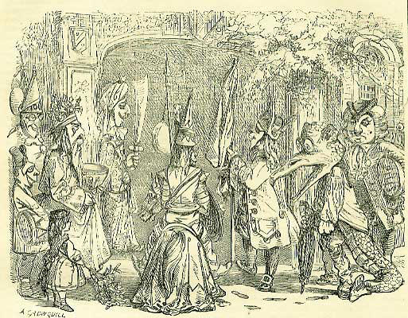
MUMMER
The earliest evidence of mummers' plays as they are known today (usually involving a magical cure by a quack doctor) is from the mid to late 18th century.
In mummers’ plays, the central incident is the killing and restoring to life of one of the characters.
thebookofdays.com
The Origins of British Mummers' Plays — article by Peter Millington from American Morris Newsletter

Slide 23
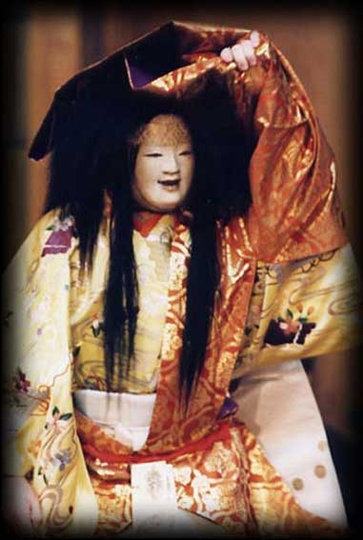
HISTORICAL
PRECEDENTS
OTHER REGIONS
canadiannikkei.ca

Slide 24
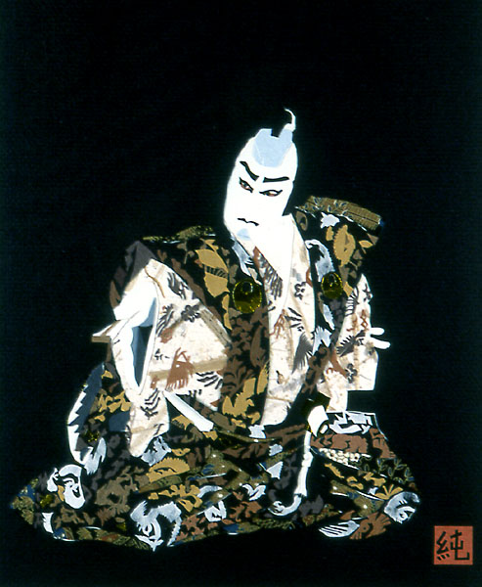
AROUND THE WORLD-JAPAN
Kabuki theater has the dammari pantomime
The Noh tradition has greatly influenced many contemporary mime and theatre practitioners because of its use of mask work and highly physical performance style
junkoyamada.com

Slide 25
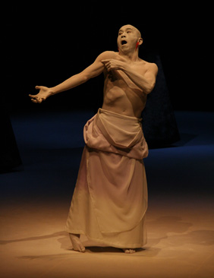
AROUND THE WORLD-JAPAN
Butoh, though often referred to as a dance form, has been adopted by various theatre practitioners
diary.ru

Slide 26
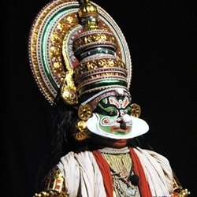
AROUND THE WORLD-INDIA
Classical Indian musical theatre, although often erroneously labeled a "dance," is a group of theatrical forms in which the performer presents a narrative via stylized gesture, an array of hand positions, and mime illusions to play different characters, actions, and landscapes
squidoo.com

Slide 27
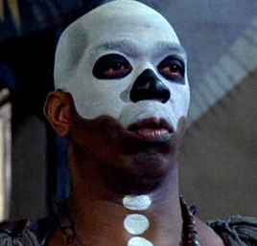
AROUND THE WORLD-AFRICA
Developed around the 5th century in the heart of equatorial Africa, near what is now the country of Chad
Used to celebrate various events of importance, such as the killing of a lion, or the onset of hippopotamus mating season
came into its own during the 17th century, when it was often used to lampoon the clumsy European explorers
http://www.thehistorybluff.com/?p=926

Slide 28
AROUND THE WORLD-AFRICA
Developed around the 5th century in the heart of equatorial Africa, near what is now the country of Chad
Used to celebrate various events of importance, such as the killing of a lion, or the onset of hippopotamus mating season
came into its own during the 17th century, when it was often used to lampoon the clumsy European explorers
http://www.thehistorybluff.com/?p=926

Slide 29
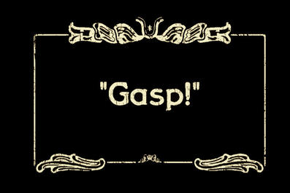
MODERN PANTOMIME
20TH CENTURY-TODAY
factfreehand.org

Slide 30
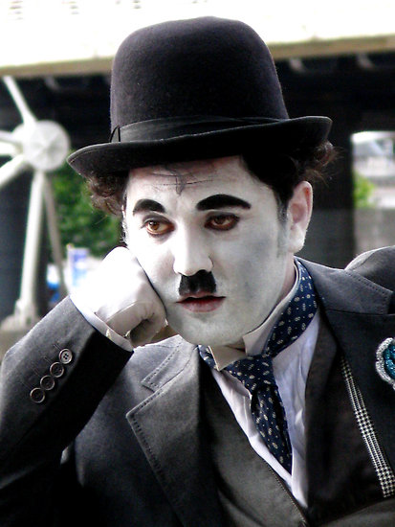
SILENT FILM-CHAPLIN
Silent film comedians like Charlie Chaplin, learned the craft
of mime in the theatre
Through film, they would have a profound influence on mimes working in live theatre even decades after their death.
Charlie Chaplin may be the most well-documented mime in history.
redbubble.com

Slide 31
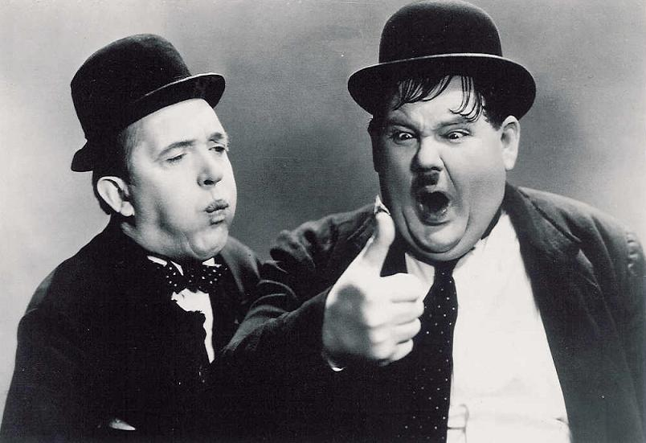
SILENT FILM-LAUREL & HARDY
In a partnership lasting 31 years, the comedy duo made 106 films spanning the silent era until the 1950s.
Laurel and Hardy made the world laugh
They were the Kings of Comedy!
visitcobh.com

Slide 32
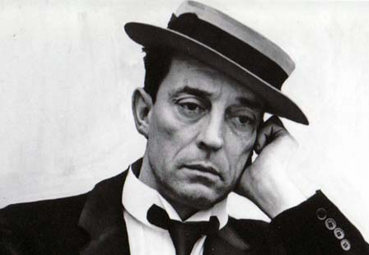
SILENT FILM-BUSTER KEATON
Buster Keaton is considered one of the greatest comic actors of all time. His influence on physical comedy is rivaled only by Charlie Chaplin.
Acrobatic and insightful, Keaton made dozens of short films and fourteen major silent features, he was one of the most talented and innovative artists of his time. He was known and loved for his “deadpan” face and calm demeanor.
For Keaton, as for many of the silent movie stars, the final straw was the advent of the talkies.
In 1953, his appearance in Chaplin’s LIMELIGHT revived Keaton’s work career with frequent appearances on television.
http://www.pbs.org/wnet/americanmasters/episodes/buster-keaton/about-buster-keaton/644/

