Slide 1
Drama 5-7: Spring Concert Prep – Production Roles
Behavior: Students will understand and sign up for Spring Concert Production roles.
Conditions: Students use the production role guideline worksheet to assign their positions.
Criteria: 100% of students will sign up for a production role, i.e. BoH, Foh, Tech, AD, SM
wsfcs.k12.nc.us
wsfcs.k12.nc.us
wsfcs.k12.nc.us

Slide 2
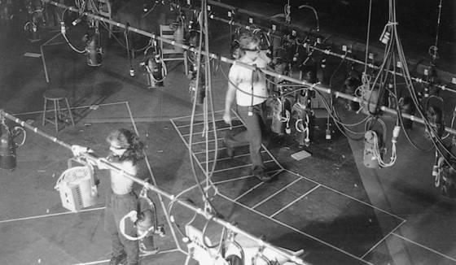
Great art conceals art.
---Konstantin Stanislavski
The process of making theatre
is artistic and artful –
but is also a business…

Slide 3
The Production Sequence
Script
Assume you start with a text but not always!
Develop the concept (a.k.a. ‘production approach’)
Production meetings
Design the production
Build/Construct the elements of the show
Rehearsal Process

Slide 4
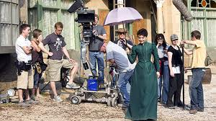
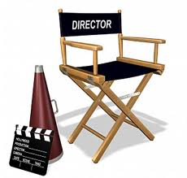
What is theater production?
3 Stages
Pre-production: Prep work before the show begins rehearsals
Auditions, Design formulation,
Production: The nitty-gritty
Rehearsals, Stag/costume development
Post-production: The tie ups
Editing, Reflection

Slide 5
The Rehearsal Process
Technical rehearsals
Devoted to integrating the sets, props, lighting, and sound with the performers
Focus on discovering patterns and timing for cues and shifts
Shift rehearsals
Devoted to choreographing the scenery changes
Controlled by the stage manager, director, and technical director
Lighting rehearsals
Devoted to cueing the show – establishes timing and intensity
Precedes the first technical rehearsal
Dress rehearsals
Occurs during the end of ‘tech’ week
Incorporates the costumes into the process

Slide 6
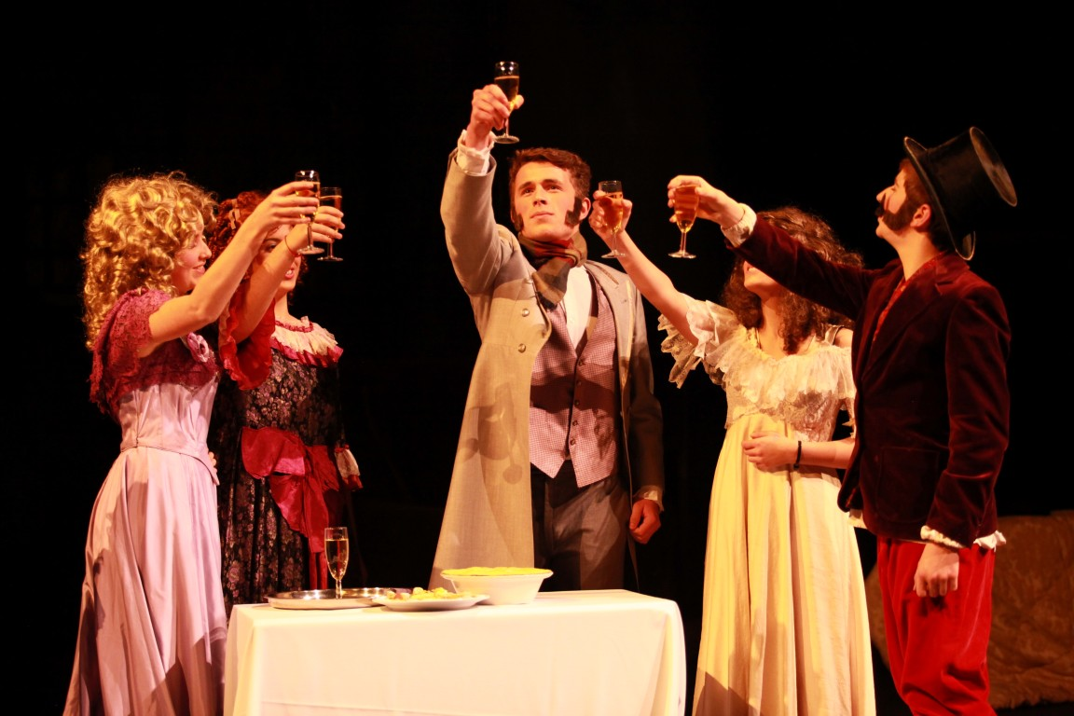
The Production Concept
The central creative idea that unifies the artistic vision of the producer, director, and designers.
Represents all ‘points of view’ involved in the creative process
Director controls the ‘unified vision’ of the whole
Designers create the pieces that support this world of the play

Slide 7
Production ROles
Producer
Director
Stage Manager
Technical Director
Playwright
Actor
Stage Crew
Costumes/
Makeup
Lights and Sound
Front of House

Slide 8
Production team Chart

Slide 9
Artistic Director
Producer
Scenic
Costume
Lighting
Sound
Playwright
Director
Production Manager
Costume
Shop
supervisor
Master
electrician
Sound crew
Actors
Stage Manager
Electricians
Stage crew
Wardrobe
run crew
Cutter/
draper
Costume
Crew
Managing Director
Props
master
Scenic
artist
Tech
Director
Prop Crew
Paint Crew
Shop
Foreman
Budget
Development
Box Office
Scenic Construction Crew

Slide 10
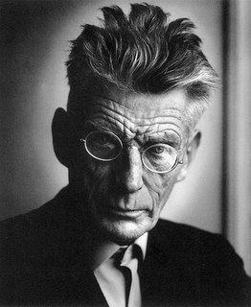
Producer: The head honcho
The producer provides most to all of the money!
The producer participates in the audition process.
Responsible for knowing and getting all the crew that is needed.

Slide 11
The Producer
Ultimate authority of the production
Secures the rights
Hires the director, designers, actors, & crews
Role varies depending on situation –
Broadway vs. Regional theatre vs. Educational theatre vs. Community/Non-Profit
Broadway – Producer is focused on single show only
Regional – Focused on season – often duties are split between managing director and artistic director
Educational – Department chair often acts as managing director with artistic duties split amongst a production committee made up of the faculty
Community / Non-Profit – Producer is usually a committee or board of directors

Slide 12
The Production Manager
Coordinates the logistics of the production process from page to stage
Develops the production calendar and oversees major scheduling
Week
0
Week
4
Week
10
Week
11
Week
13
Rehearsals
Design
Performance
Construction
Technical and dress rehearsals
Opening
Closing

Slide 13
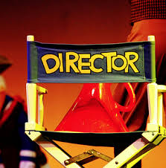
Director: Their vision, their world
The director is responsible artistic vision of the play.
Translates all artistic aspects of the production in their vision.
Script, Choreography, Stage/Sound/Lighting/Costume Design, Acting
The assistant director (AD) helps the director in communicating these ideas to the cast and crew.

Slide 14
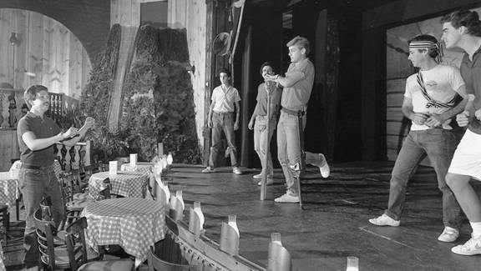
The Director
Artistic manager and inspirational leader of the production team!
Ultimately responsible for the unified creative representation of the play
–
From actors to designers, the director has the ultimate vision and the ultimate veto power

Slide 15
The Playwright
Creates and develops the ideas that ultimately evolve into the written script
If a living playwright, may be involved in initial rehearsals / performances
Offers insight into characters
Interprets plot developments
Rewrites as needed
Often not available - so production team proceeds with development and interpretation on their own

Slide 16
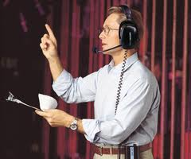
Stage Manager
The stage manager is the coordinator and organizer of the production.
This person records all technical and blocking information for the director.
During the performance, they coordinate cast and crew and make sure costume and prop presets have been completed, and controls the show by calling the cues.

Slide 17
The Stage Manager
Major communicator for the production process – 2 categories of duties:
1. Assisting the director during the rehearsal process
Conveys what occurs in rehearsal to the production team
Manages the actors and takes blocking
2. Being responsible for all backstage activity after the show opens
Orchestrates the technical rehearsals with the director and technical director
Call the show – Light, sound, and scenic cues
Creates and maintains the prompt book – the ‘bible’ of the production

Slide 18
Do now DO now do now
Get out your black portfolios and think of our Stagecraft Play;
DOROTHY AND THE WIZARD OF OZ
In your portfolios, briefly write down some “IN YOUR MIND” ideas. Here are some brainstorm cues;
What does the land of OZ look like to you?
What time/season does your OZ take place?
How would you describe what the characters in your mind look like and are wearing?
Describe the sets would you build to create YOUR version of the land of OZ?

Slide 19
Wicked Design Concept
What is a Design Concept?
A design concept is the idea behind a design. It's how you plan on solving the design problem in front of you.
It's the underlying logic, thinking, and reasoning for how you'll design a website.
Your concept will lead to your choices in color and type.

Slide 20
The Designers!

Slide 21
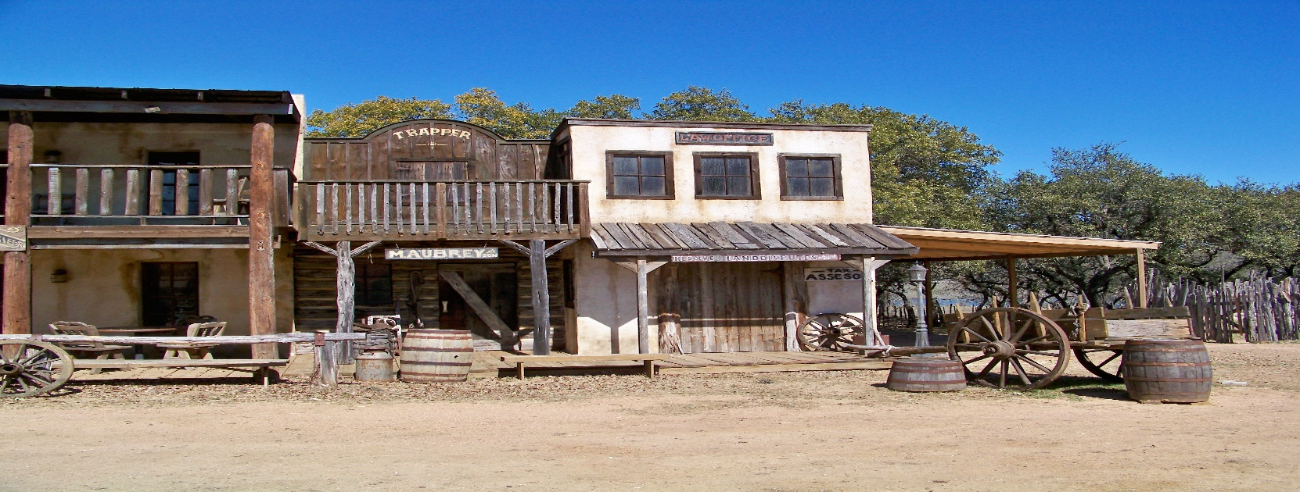
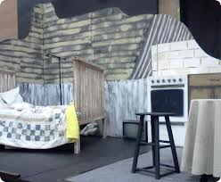
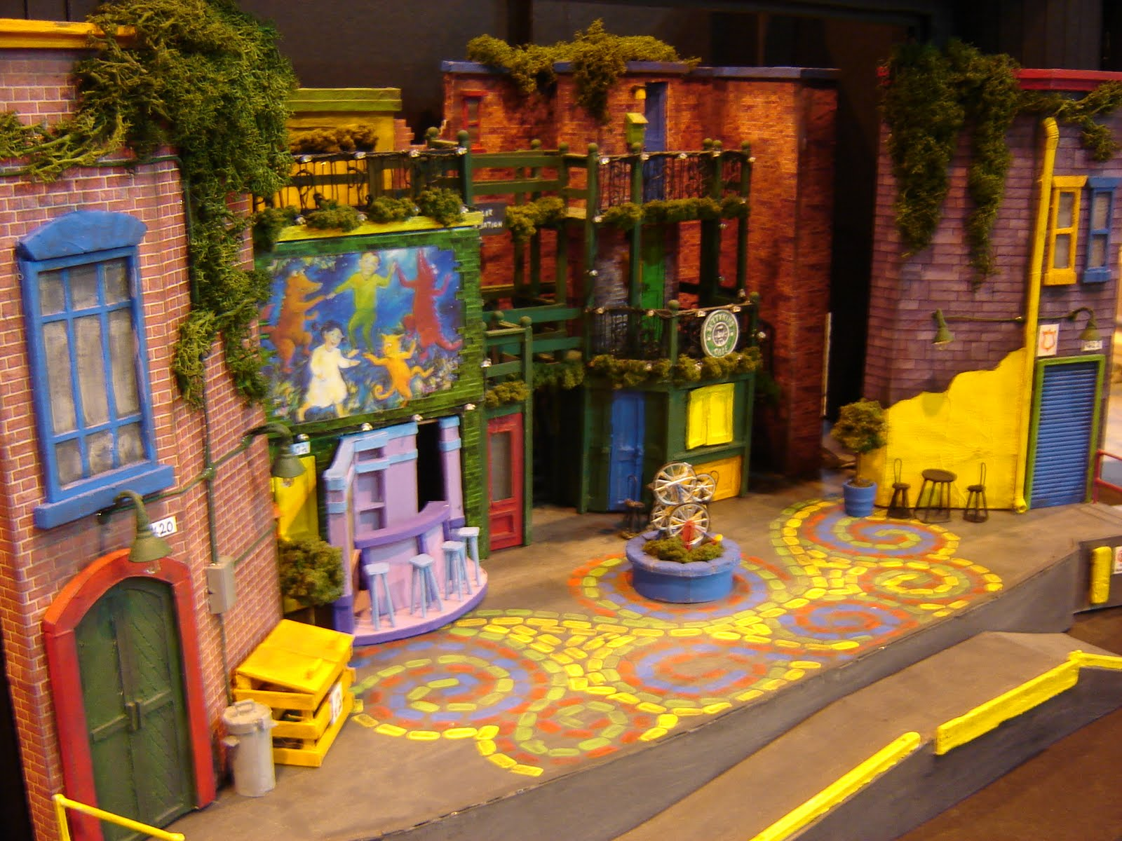
Scenic Designer
In charge of creating the SCENERY of a theatrical production.

Slide 22
Scenic & Props
Scenic Designer: Responsible for the visual appearance and function of the scenic and property elements used in the production
Scenic Artist: Paints the scenery
Paint Crew: Paints the sets and sometimes the props
Property Master: Responsible for the construction of all props in the play
Property Crew: Constructs or acquires the props for the play
Technical Director: Either a master craftsperson who builds the set or a technical administrator
Scene-Shop Foreman: Responsible for the construction, mounting, and rigging of the scenic pieces
Construction Crew: Responsible for building the set pieces and props
Stage Crew: Responsible for the running and maintenance of the set during the technical rehearsals and performances

Slide 23
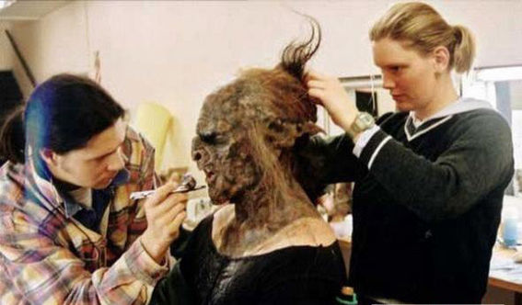
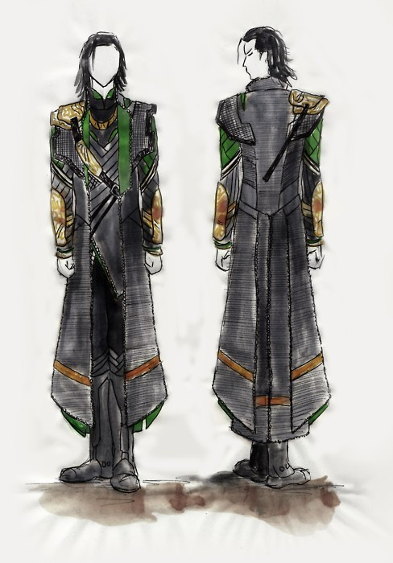
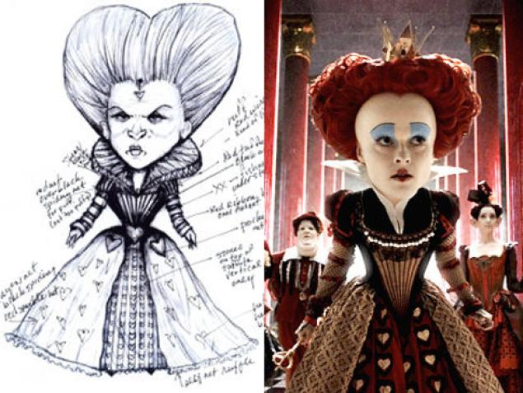
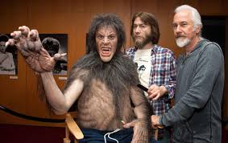
Costume & Makeup designer
The person or team who makes costumes and designs Makeup for any given production

Slide 24
Costumes
Costume Designer: Responsible for the visual appearance of the actors
Costume Shop Supervisor: Builds (or supervises) the costumes as specified by the designer
Costume Crew:
Cutter/Draper: Responsible for translating the designer’s sketches into reality
First Hand: Supervises the construction of the garments
Stitchers: Construct the garments and do hand-sewing as needed
Dyers/painters: Dye and paint fabric as needed
Milliner: Constructs hats
Wigmaster: Makes, styles, and arranges wigs
Costume Craftsperson: Specialist that constructs period apparel
Wardrobe Supervisor: Responsible for all costumes during the run of the production

Slide 25
Make-up
Make-up Designer: Responsible for the design and execution of make-up
Make-up Crew: Usually needed if people are required to execute special make-up such as prosthetics and/or ‘effect’ make-up such as scars or blood
Most often actors are responsible to put on their own make-up with the approval of the costume designer.
Basic make-up is referred to as ‘street makeup’.

Slide 26
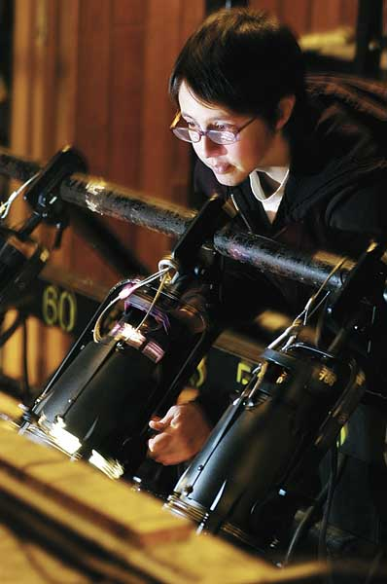
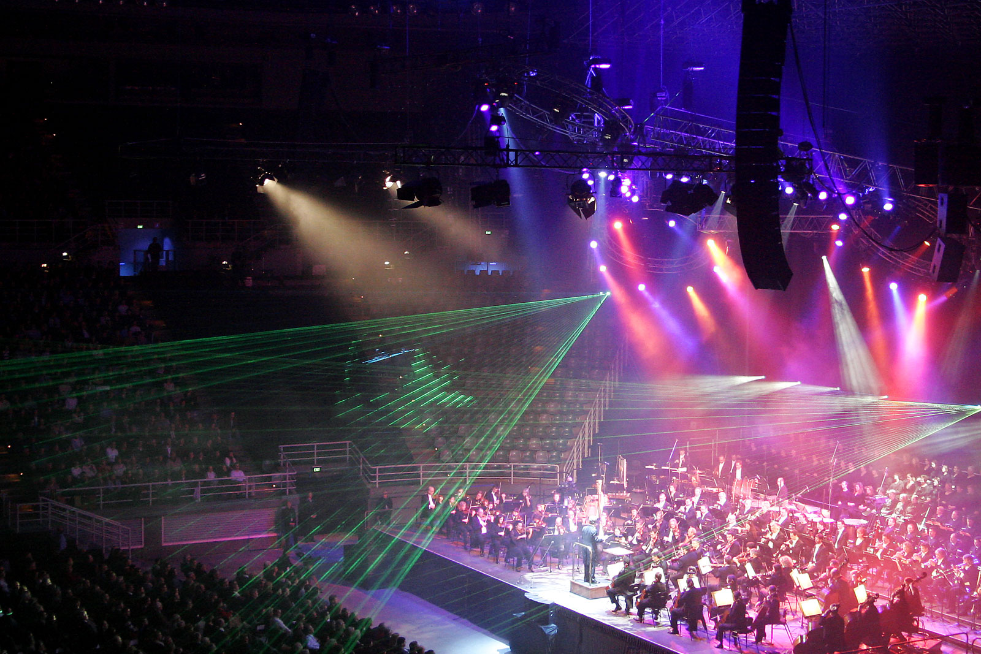
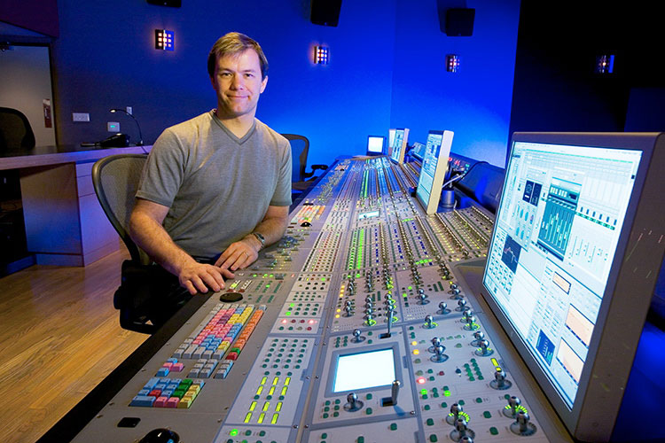
Light & Sound Designer
People responsible for the LIGHT & SOUND schemes for any given production.
WHY IMPORTANT?
Sets MOOD, TONE, and ATMOSPHERE of the show

Slide 27
Lighting
Lighting Designer: Responsible for the design, installation, and operation of the lighting and special electrical effects used in production
Asst. Lighting Designer: Responsible for producing and maintaining the paperwork necessary to implement the designer’s vision
Master Electrician: Implements the lighting design – acquires, installs, and maintains the equipment while supervising the crew
Electricians:
Hanging: Places instruments in place designated by the designer – circuits and patches them as well
Focusing: Once in position the hanging crew focuses (aims) the lights and puts in color media under the supervision of the designer
Running: Responsible for the operation and maintenance of the instruments during the run of the production

Slide 28
Sound
Sound Designer: Responsible for the design, recording, equipment set-up, and playback of any sound used in the production.
Sound Crew: Responsible for the actual recording, editing, and playback of sounds during rehearsals and performance
Also responsible to run any sound reinforcement required for the production

Slide 29
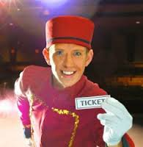
Stage Crew / Front of House
Stage Crew
Handles all of the physical labor;
Moving, organizing and assisting in the production
of the show.
Front of House
Organizes most to all Audience/Publicity needs
Takes tickets, hands out programs, ushers audience members to their seats

Slide 30
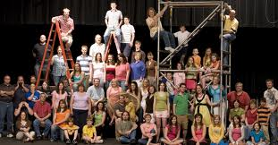
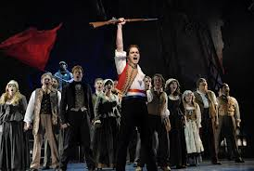
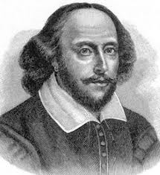
The Actors

Slide 31
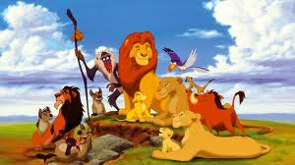
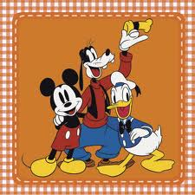
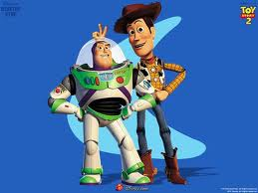
Disney Takes a Stand: Bullying
3 Different PSAs (public service announcements)
Hallway Harassment
Bus Intimidation
Cyber Bullying
http://www.commonsensemedia.org/cyberbullying

Slide 32
Hallway Harrasment
Mickey and Minnie are being Verbally harassed by Simba in the school hallway.
What can Billy and Sarah learn from this situation?
Billy and Sarah enter the Hallway Harrassment World and witness trouble.
2. Scene
3. PSA Talk Back
Cast
Principal Tiana
Minnie Mouse (victim)
Mickey Mouse (victim)
Simba (bully)

Slide 33
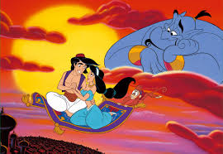
Intimidation on the Bus
Cast
Bully: Alladin
Witness: Stitch
Victim: Lilo
Bus Driver: Lightning McQueen
Brave Triplets (Rap Chorus)
Situation: Target and Witness sit across the aisle from each other doing their own thing when the bully gets on and chooses to sit with the target and forces him/her over to the window side of the seat where he/she is trapped.
Billy & Sarah enter their bus world.
Scene
PSA Talk Back

Slide 34
Cyber Bullying
Rules of the Road for Kids
1. Guard your privacy. What people know about you is up to you.
2. Protect your reputation. Self-reflect before you self-reveal. What’s funny or edgy today could cost you tomorrow.
3. Nothing is private online. Anything you say or do can be copied, pasted, and sent to gazillions of people without your permission.
4. Assume everyone is watching. There’s a huge, vast audience out there. If someone is your friend’s friend, they can see everything.
5. Apply the Golden Rule. If you don’t want it done to you, don’t do it to someone else.
6. Choose wisely. Not all content is appropriate. You know what we mean.
7. Don't hide. Using anonymity to cloak your actions doesn’t turn you into a trustworthy, responsible human being.
8. Think about what you see. Just because it’s online doesn’t make it true.
9. Be smart, be safe. Not everyone is who they say they are. But you know that.
Cast
Hulk (bullies friend)
Wolverine (bully)
Merida (witness)
Rapunzel (victim)
Billy and Sarah enter the cyberbully world.
Scene
PSA

Slide 35
Production Meetings!
Vital for smooth communication
Forum for open discussion amongst designers
Place to show sketches, ideas, and designs
Initially only the designers and director
Add stage manager and technical director once construction phase begins
Developmental Informational
Communication is VITAL!!!
(Shift now to ‘remote conferencing’ due to technology)

Slide 36
DO NOW DO NOW DO NOW
SIT AND GET OUT YOUR …
COMMERCIAL BRAINSTORM WORKSHEET
GET READY TO PRESENT YOUR IDEAS TO THE CLASS.

Slide 37
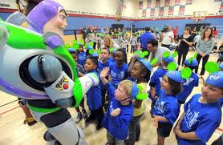
Cast List
Billy & Sarah
Hulk (bullies friend)
Wolverine (bully)
Merida (witness)
Rapunzel (victim)
Alladin (bull)
Stitch (witness)
Lilo (victim)
Lightning McQueen (bus driver)
Brave Triplets (Rap Chorus)
Principal Tiana
Minnie Mouse (victim)
Mickey Mouse (victim)
Simba (bully)

Slide 38
Name | Actors (12) | Stage Crew (2) | Front of House (2-4) | Light & Sound(1-2)
1. Melvin Appiah | Simba
2. Marcus Barnes | Stitch 2 | X
3. Auria Cook | Minnie Mouse |  | X
4. Jaylen Davis | Rap Chorus, Wolverine(robin)
5. Jahmaih Dunhar | Stitch
6. Jordyn Davis | Rap Chorus/Rapunzel 2 | X | X
7. Lucina Giles | Rapunzel 1
8. Malachi Moore | Rap chorus, Mickey Mouse |  | X
9. Johnny Morales | Aladdin | X
10. Yaslee Ocean | Mirada 1
11. Marihah Payton | Lilo
12. Ramir Phillips | Hulk / Rap Chorus
13.Gabby Pierre | Lilo 2 | X | X | X
14. Dana Plummer | Sarah |  | X
15. Basheer Salem | Billy
16.Anniyah Smith | Princess Tianna
17. Brandon McDaniel | Lightning McQueen |  | X
18. Myesha Brogdon | Merida 2 |  |  | X

Slide 39
Production Roles Quiz On a separate piece of paper, Write the correct role with it’s description on the line provided.
Word Bank:
Stage Manager Costume Designer Front of House
Producer Technical Director Stage Crew
Playwright Actor Director
Light & Sound Designer
1.____________________________ A person who is in charge of the artistic vision of a production.
2.____________________________ A performer in a given production.
3.____________________________ The person who designs, builds, and coordinates the construction.
4.____________________________ People who focus on “audience” needs, i.e. tickets, ushering.
5.____________________________ The “muscle” or “movers” of the production.
6.____________________________ Someone who makes clothes and props for a production.
7.____________________________ The lead coordinator and organizer of all backstage duties.
8.____________________________ The “money” behind a production. The head-honcho.
9.____________________________ The person responsible for writing the production’s script.
10.___________________________ The people involved with creating the light and sound design.

Slide 40
Do now do now do now do now
Continue your Company’s Invention Creation!
Each designer is responsible for their Company’s design…
Sound – Complete your jingle.
Costume – Draw and color character costumes
Playwright – Complete Plot Structure worksheet (Director will assist)
Publicity – Complete the Logo Design with detailed color illustration.

