Slide 1
REVIEW
TIME!

Slide 2
Pantomiming Helps Actors to communicate:
CHARACTER
In pantomime one person can pretend to be anyone.
Examples: Age (crawling, walking with a cane, etc.), Job(doctor, bus driver, teacher)
SETTING
Show where you are by your actions.
Examples: Brushing your teeth (bathroom), Shoveling snow (outside in winter)
EMOTION
The body always shows what you are feeling inside.
Examples: Reactions and feelings in different situations (Scared in a haunted house)

Slide 3
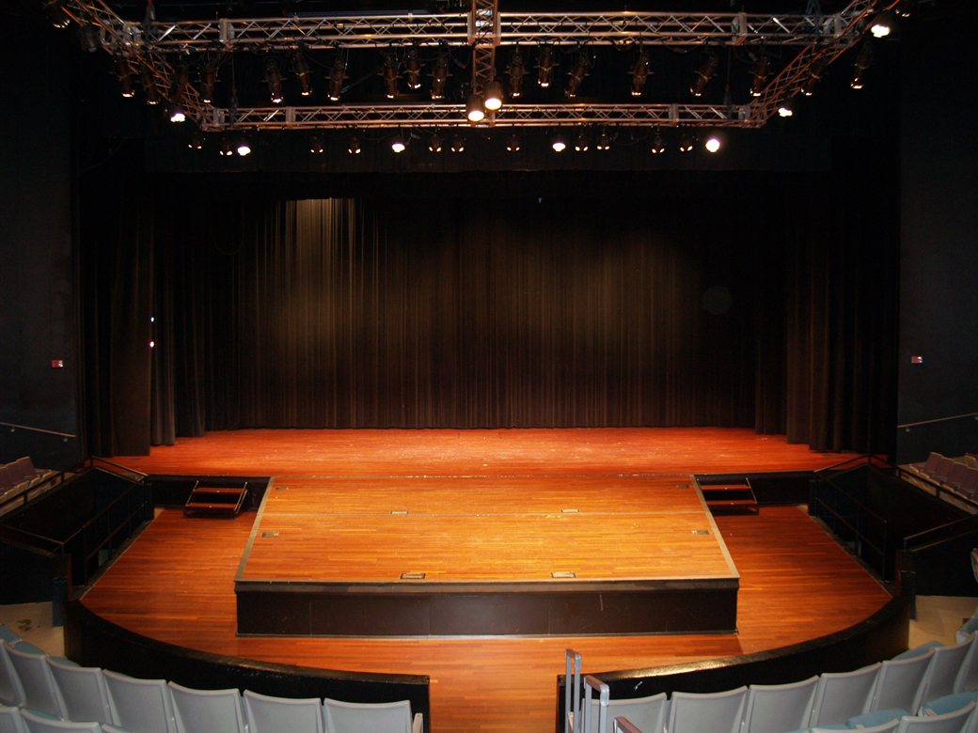
Blocking
Where we go on stage!

Slide 4

Cue
The signal to enter the stage or begin acting!

Slide 5
Snow White Gesture Review
Comb your beautiful hair
Lay flowers on the grave!
Sneak through the dark forest.
Eat your dwarf dinner.
Work in the mines!
Eat the poison apple!
Laugh evilly!
Ride in on your horse!

Slide 6
Rehearsal Time

Slide 7
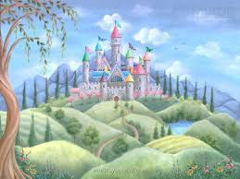

Slide 8
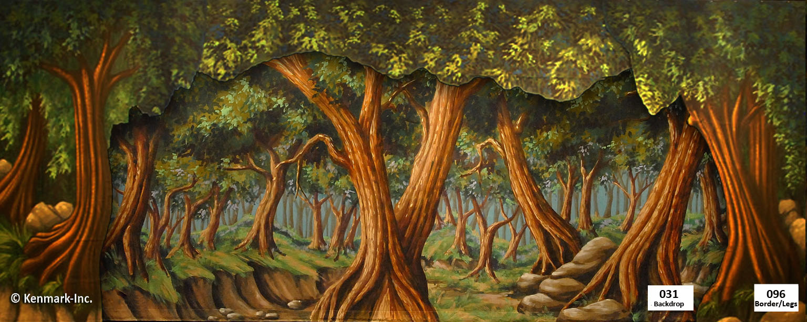

Slide 9


Slide 10
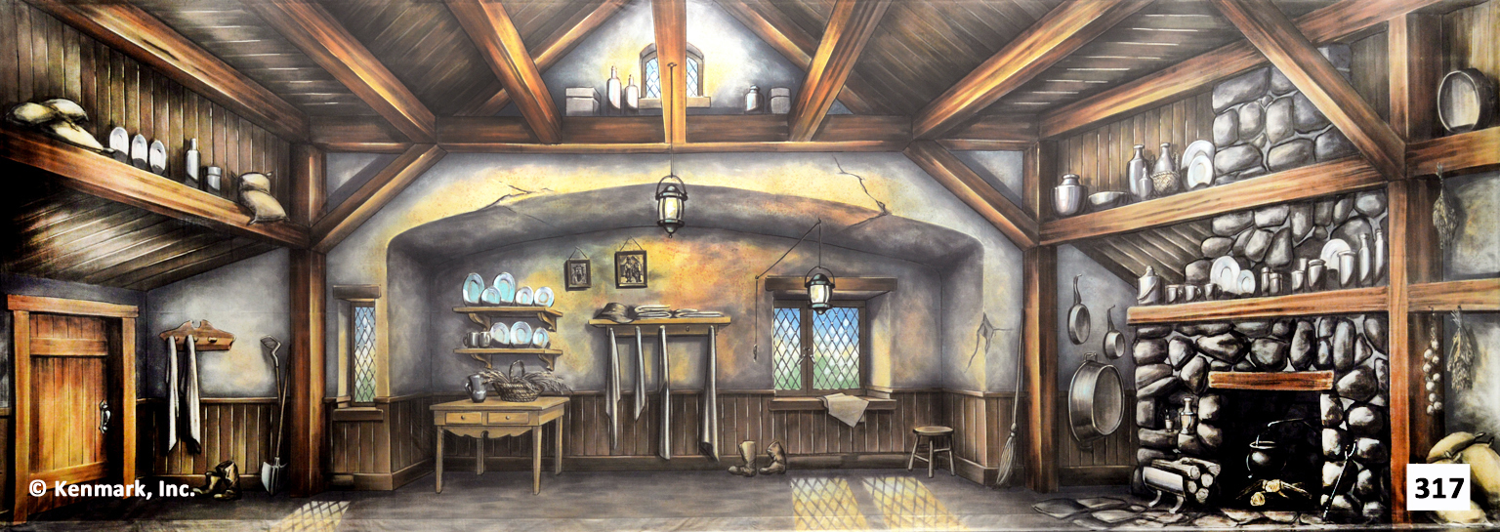

Slide 11
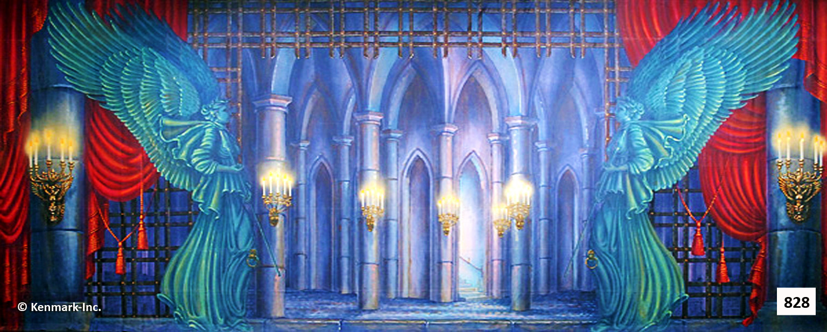

Slide 14
DO NOW
Happy New Year &
Welcome back to Drama!
Please title a new, unit entry into your portfolio;
“Intro to Pantomime”

Slide 15
DO NOW
Take out your Characterization Projects.
We will take class time to show and tell our project to the class.
Describe your costume, mask or makeup design.
Tell us why you chose your character.
Give us reasons why you make your design choices.

Slide 16
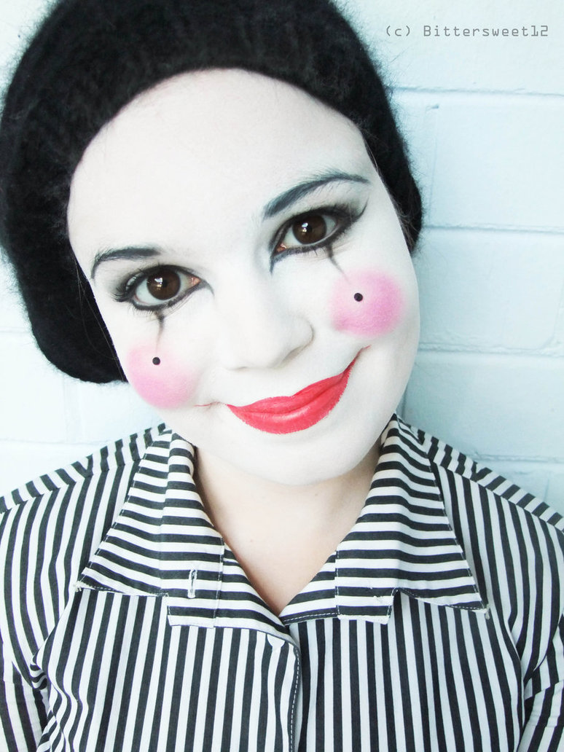
Pantomime
The art of communicating a story without words.
https://www.youtube.com/watch?v=FPMBV3rd_hI
https://www.youtube.com/watch?v=pO4Dfv_jxfE

Slide 17
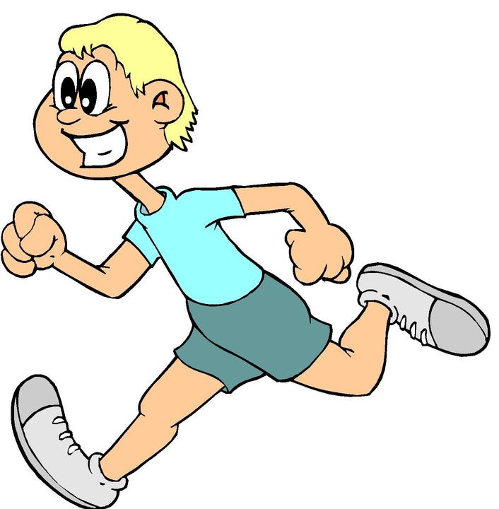
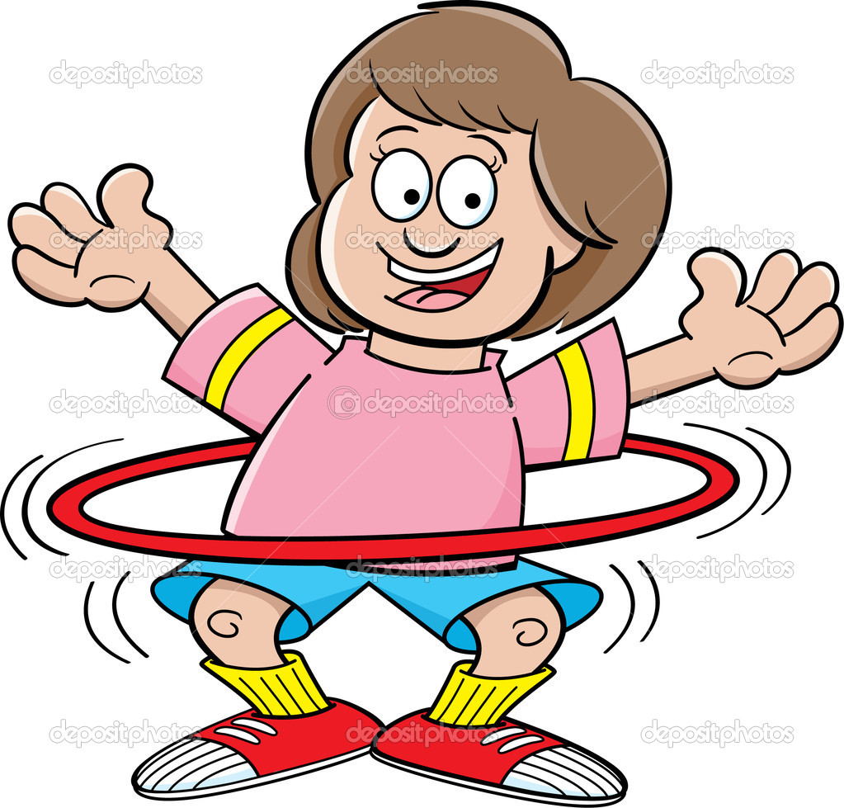
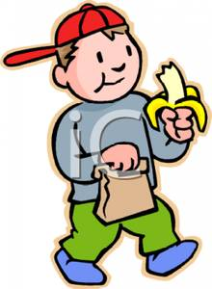
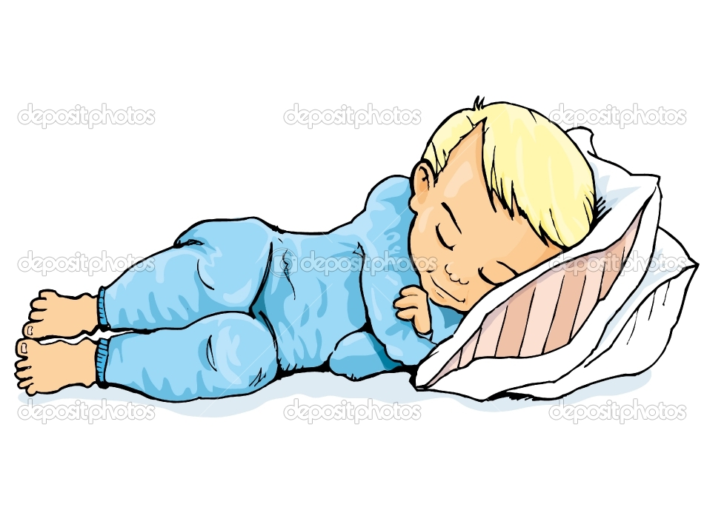
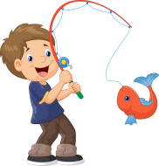
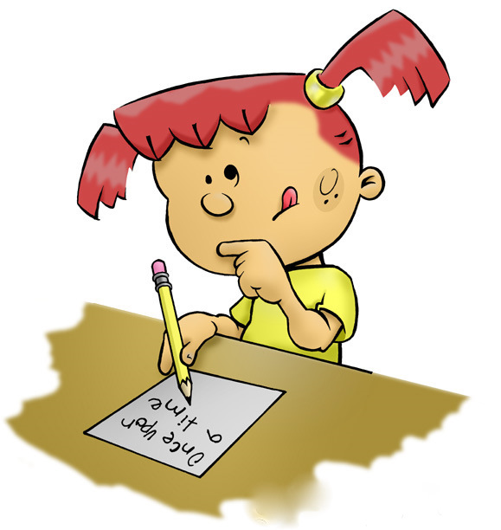
GESTURE
Showing how we move!

Slide 18
You GESTURE everyday!!!
Everyday Gestures indicating:
• “Yes”
• “No”
• “Come here”
• “Go away”
• “Hello”
• “Goodbye”
• “This tastes terrible”
Yawning widely!
Bee Buzzing around your head!
Swimming in a pool
Lifting weights

Slide 19

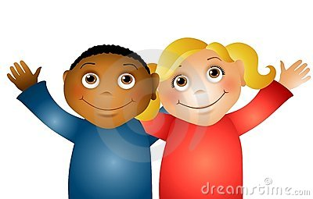
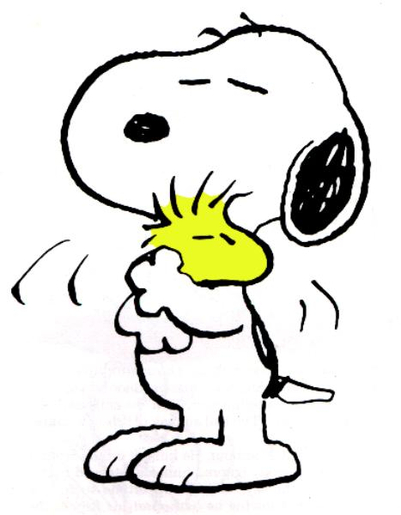

WHAT TO DO WITH OUR HANDS?!
Friendly
Angry
Ashamed
Loving

Slide 20
Mime-it-Down-the-Alley
Round one = practice using the actual object and pass it on
Round two = pass the same object, but use pantomime only, no speaking!
Round three = Mime-it-Down-the-Alley
(person at the end of the line chooses the pantomimed object to pass along)

Slide 21
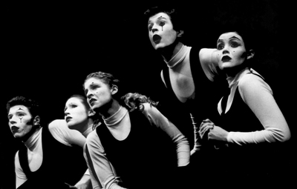
What is Pantomime?
Mime is one of the oldest forms of Theater
Comes from the Greek word…
Pantominios
  “All Imitating”

Slide 22
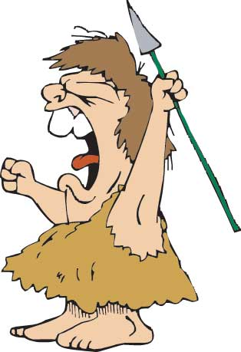
History of Pantomime
Oldest means of dramatic expression
  Successful hunts
  Victorious battles
First actors used to express their hopes for the future, along with:
  Dance
  Chants
Ancient Rome “half-time shows”
Elizabethan period “dumb shows”

Slide 23
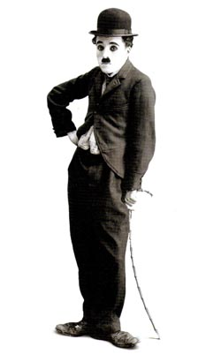
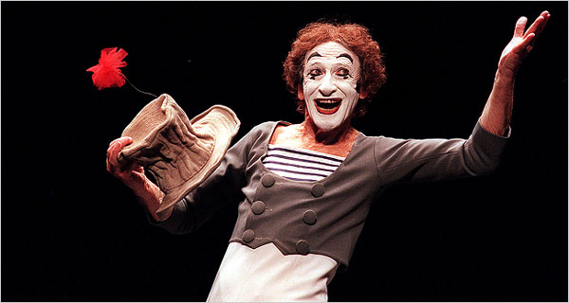
People of Pantomime
Silent movies
  Charlie Chaplin (early 1900’s)
  Marcel Marceau (1950’s)

Slide 24
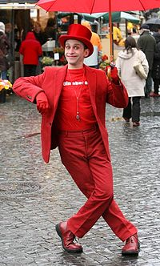
PANTOMIMING
Imitates actions from real life
No props; has imaginary
objects
Must have a…
  Beginning, Middle, and End
http://www.youtube.com/watch?v=jLrLNehzpb8 (video)

Slide 25
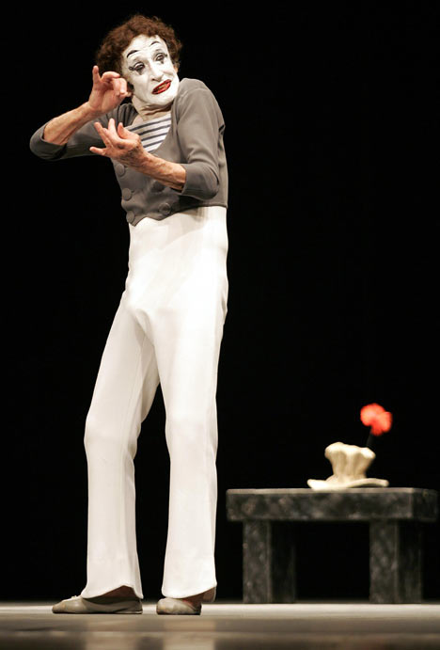
Principles of Pantomime
Creating an object in pantomime
  Visualize the object. See it in your mind.
  Approach the object. Move toward it.
  Take the object. Make contact with it.
  Tell the audience its location, size, shape, weight.
  Release the object. Let go.

Slide 26
DOs of Pantomime
  DO exaggerate facial expression
  DO show the shape, size, weight of objects
  DO focus fully on the task
  DO show the audience who you are, where you are and what is happening
  DO plan a beginning, middle and end
  DO include conflict or a problem

Slide 27
DON’Ts of Pantomime
  DON’T mouth words
  DON’T make any noise
  DON’T use props
  DON’T include body contact
  DON’T include violence, weapons, etc.

Slide 28
Gesture Practice
Relief (“Phew!”)
Impatience (“You’re late!”)
Calling someone over (“Come here!”)
“No, thank you.”
Excitement (“I can’t wait!”)
Begging (“Pretty please?!?”)
Approval (“That’s great!”)

Slide 29
Object Practice
Talk on the phone
Open a can of soda
Type on the computer
Pick up a pencil
Pick up a bowling ball

Slide 30
Individual Pantomimes
Keep it Simple! Examples:
  Walk along the street and get bubble gum stuck to the bottom of your shoe.
  Try to open your locker. It is jammed.
  Wash your face and get soap in your eyes. Look for a towel.
  Put on a pair of shoes that are too tight.
  You have been robbed and your hands are tied behind your back. Try to call the police on the telephone.
  You can’t find the right key to open the lock on the door.
  Drink a large glass of water and then discover you have swallowed a bug.
  Eat a piece of candy and then realize you ate a piece of cat food by mistake.

Slide 31
Principles of Pantomime
Chest is the key
  Positive emotions = high, expanded, free, broad, animated gestures
  Negative emotions = tense, contracted, restricted gestures
Use upstage arm
  Avoid covering your face while expressing emotion
Direct your story to your audience
All movement should be clearly motivated
Use posture/movements expected of your character
Concentrate!
Practice!

Slide 32

Empty Space
What different things can you fill our stage with?!
Emotion
Character
Scenery
Story
Anything!

Slide 33
Pantomiming Helps Actors to communicate:
CHARACTER
In pantomime one person can pretend to be anyone.
Examples: Age (crawling, walking with a cane, etc.), Job(doctor, bus driver, teacher)
SETTING
Show where you are by your actions.
Examples: Brushing your teeth (bathroom), Shoveling snow (outside in winter)
EMOTION
The body always shows what you are feeling inside.
Examples: Reactions and feelings in different situations (Scared in a haunted house)

Slide 34
Pantomime Notes continued…
A pantomime MUST follow a solid storyline:
Beginning: Background info (who, what, when, where, why)
Middle: Conflict & ACTION
(conflicts are interesting, create action, show relationships, etc.)
End: Conclusion (problem solved--can be slightly non-realistic)

Slide 35

GESTURE IN A HAT!

Slide 36
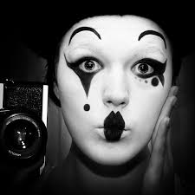
Practice Time!!!
The audience must be able to see your facial expressions and body movements at All times!
https://www.youtube.com/watch?v=oVnKSEjQlC4

Slide 37
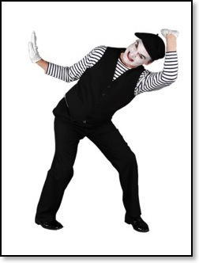
You’re NOT going to pretend you’re stuck in a box!!!!
We want Gesture!!

Slide 38
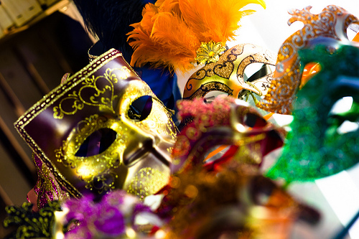
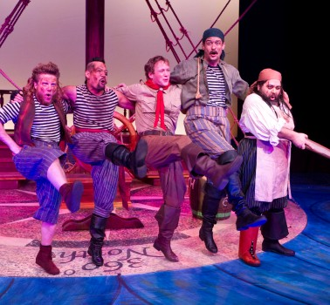
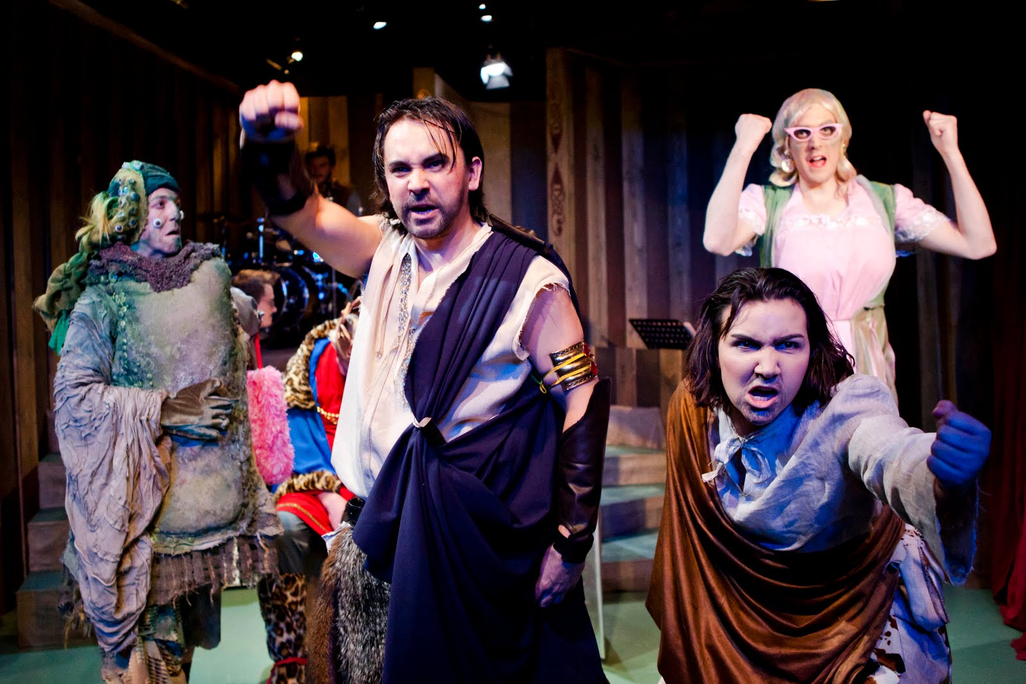
MUSICAL PANTOMIIME
https://www.youtube.com/watch?v=iUg9UtGJIDA
https://www.youtube.com/watch?v=Lncp59918VE
https://www.youtube.com/watch?v=Lt2iOdafBqM

Slide 39
DO NOW
Take out your portfolios and wait for Mr. Seidel to hand back your pantomime worksheets.
We will start with a drama game and then jump into our class project.

Slide 40
Musical Pantomime
You will have 15 minutes to rehearse ACTING OUT your pantomime to your musical choice.
  Make sure your pantomime last the whole length of the song.
  Be clear and keep your pantomime motivated by the music.
  This will count as a performance assessment grade.

Slide 41
Pantomime Notes continued…
* The audience must be able to see your facial expressions and body movements at All times!

Slide 42
Pantomime Notes
* To successfully pantomime something you
must Imitate and Imagine it!!!
* Make sure the settings, characters, situations, and emotions are believable!!!
* To make something look realistic, you must always show the size, shape, weight, resistance, texture, placement, and condition of objects!!!

Slide 43
Pantomime Notes continued…
Resistance: always make movements easy to see, sharp, crisp, and believable
Consistency: always keep the characters, location, objects, and ideas the same for the whole scene
Exaggerated Facial Expressions and Gestures: keep them specific and realistic, but make them more obvious

Slide 44
Mime vs. Pantomime
  Pantomime: imitation of real life/based on reality, exact, imaginary objects used, no sound
  Mime: abstract and stylized, a greater meaning is conveyed, the action conveys the theme, a part of the body can become an object, nonverbal sounds can be used (telephone busy signal, horn honking, screech of tires), beyond reality

Slide 45
Objectives
Ticket out the door: Write each in your own words
Students will understand and demonstrate the basics of pantomime, such as, facial expression, body movement, personality, and observation.
Students will use a range of emotional, psychological, and physical characteristics and behaviors to portray believable characters through improvisation and pantomime.
Students will act in an ensemble to create and sustain characters that communicate with an audience.
Students will create scripts based on personal heritage, imagination, and literature through improvisation and pantomime.

Slide 46
Homework
Pantomime an everyday activity
  Examples: making a sandwich, curling your hair, making dinner
Practice at home with the real objects
Performance needs to be at least 1 minute long
Make us believe that the object is really there

