Slide 1
Intro to Improv
Behavior: Students will apply their understanding of the basics of improvisation by identifying improv skills and defining guidelines. 1.3.8.C.1
Conditions: Students will write, analyze and perform a series of improv games (Improv Adventures) geared towards the learned guidelines set by the instructor. 1.3.8.C.1
Criteria: After lecture and performance, students will receive 3 or higher on their Improv Performance Rubric guide.

Slide 2
DO NOW, DO NOW, DO NOW
Choose a Story Theme, Character and Setting of your choice! Write it down on the supplied notecard.
For example: Fantasy / Cinderella / A Secret cave
http://www.youtube.com/watch?v=YZtN8_xrd9o
http://www.youtube.com/watch?v=oCdkV8MOcDQ

Slide 3
DO NOW, DO NOW, DO NOW
Take your BLACK PORTFOLIO BINDER.
Complete the Improv worksheet located on Mr. Seidel’s desk.
http://www.youtube.com/watch?v=YZtN8_xrd9o
http://www.youtube.com/watch?v=oCdkV8MOcDQ

Slide 4
DO NOW, DO NOW, DO NOW
Take one of the magazines from the Drama Cart
Read the article
“How They Got There” on page 18
After you’re finished write a few sentences commenting on how you felt about the reading.
http://www.youtube.com/watch?v=YZtN8_xrd9o
http://www.youtube.com/watch?v=oCdkV8MOcDQ

Slide 5
HOMEWORK
PADLET ENTRY!
Go to Mr. Seidel’s OPA Website!
Click the Drama 8, Beginner’s link

Slide 6
DO NOW DO NOW DO NOW
Write 3 Improv Character Ideas on the notecards provided; located on Mr. Seidel’s Desk.
For example: Darth Vader
Man who discovers he is turning into a baby.
A Pirate who has lost his booty.
President Barack Obama
http://www.youtube.com/watch?v=YZtN8_xrd9o
http://www.youtube.com/watch?v=oCdkV8MOcDQ

Slide 7
DO NOW DO NOW DO NOW
Write 3 Improv Character Ideas on the notecards provided; located on Mr. Seidel’s Desk.
http://www.youtube.com/watch?v=YZtN8_xrd9o
http://www.youtube.com/watch?v=oCdkV8MOcDQ

Slide 8
DO NOW DO NOW DO NOW
How can students take risks and creatively express themselves through the use of improvisation?
Please answer the Essential Question in your portfolio.
http://www.youtube.com/watch?v=YZtN8_xrd9o
http://www.youtube.com/watch?v=oCdkV8MOcDQ

Slide 9
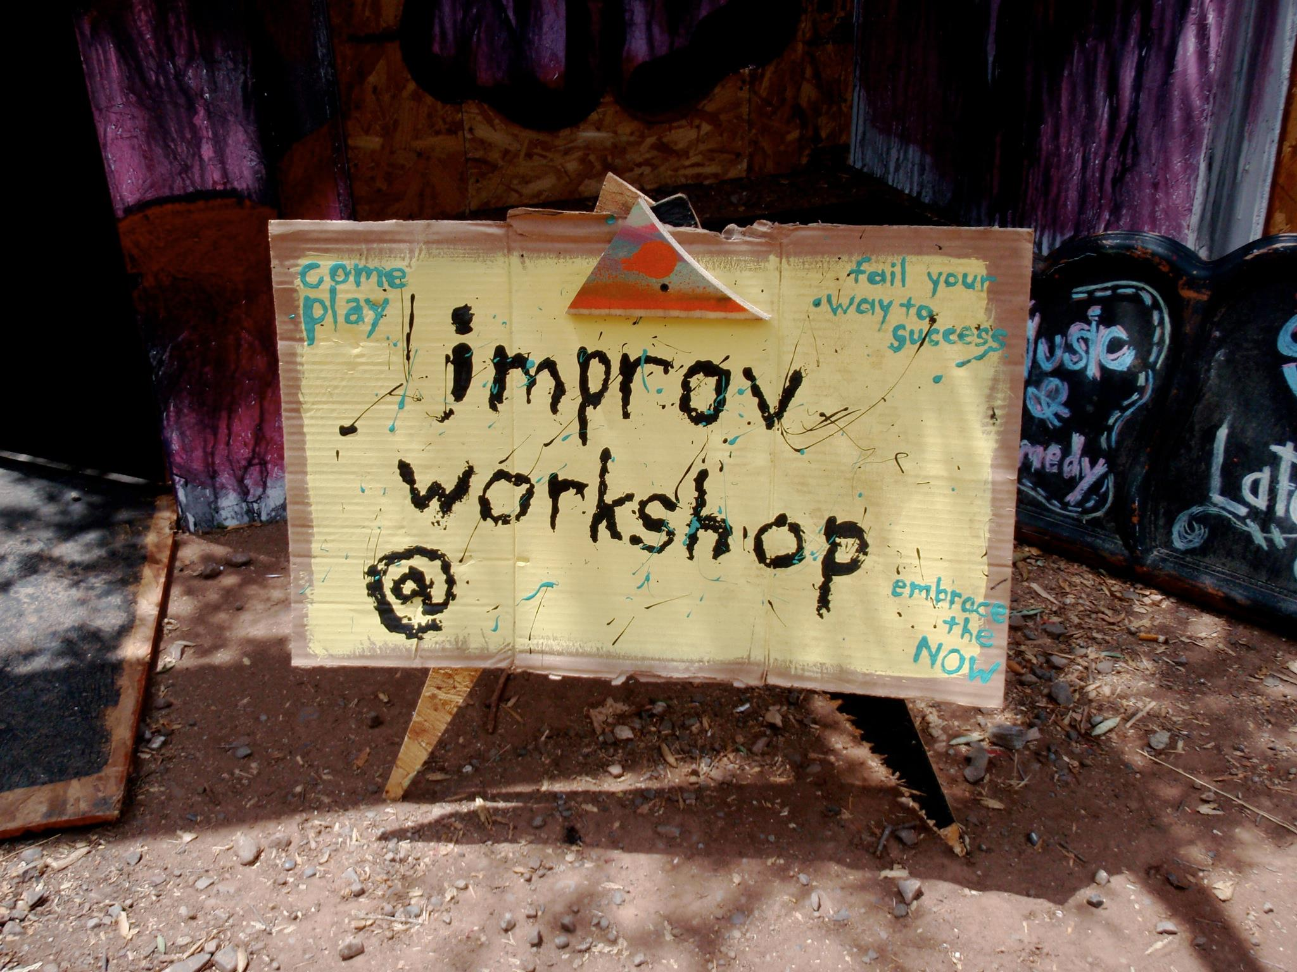
What is Improvisation?
A spontaneous style of theatre using unrehearsed and unscripted acting scenes.
Thinking, Doing, & Saying on your feet!

Slide 10

Improv Do’s!
1. Commit 100%
2. Listen to the other players
3. Establish your setting!
4. Forward the Action!
5. JUST SAY YES!

Slide 11
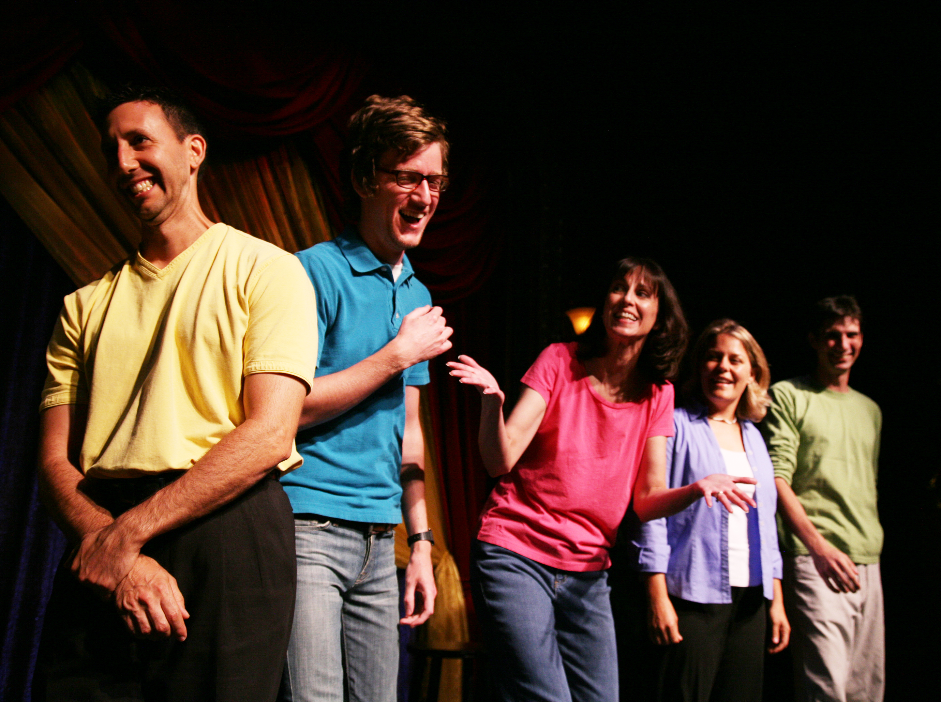
Improv Dont’s!
1. NEVER SAY NO!
2. Don’t just tell. SHOW US!
3. Don’t force funniness.
4. Don’t worry about making mistakes.

Slide 12
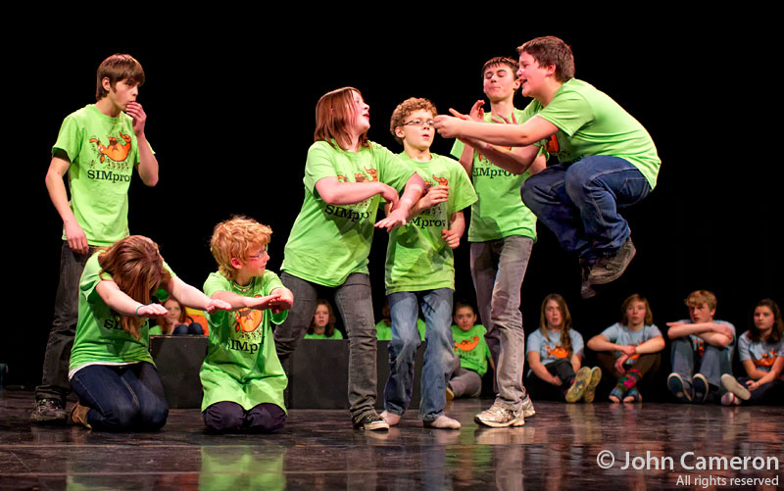
Improvised Theatre
Also known as Improv, a group of performers create original scenes and characters on the spot.
Sketches : Specific scenes which is provided by the audience or another member of the group.

Slide 13
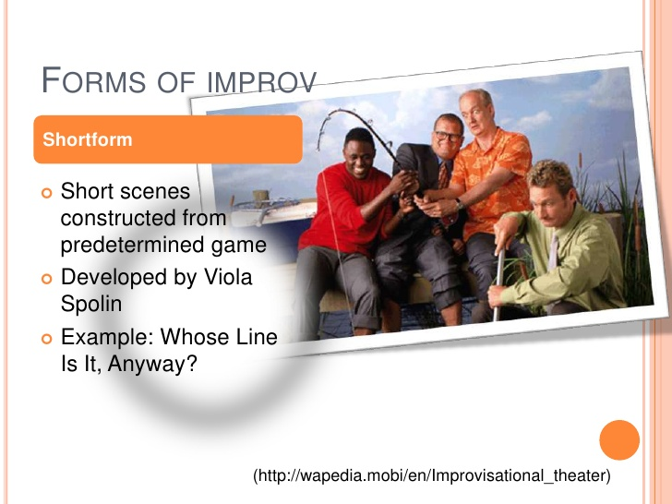

Slide 14
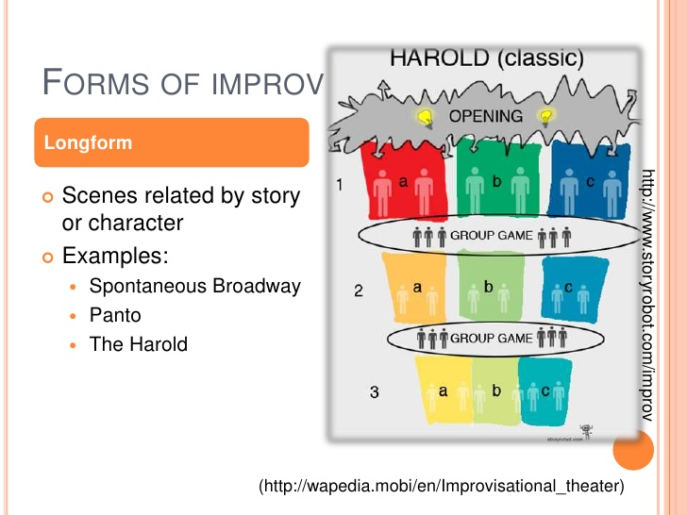

Slide 15
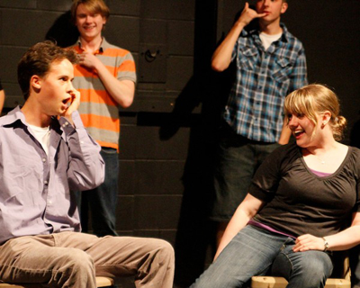
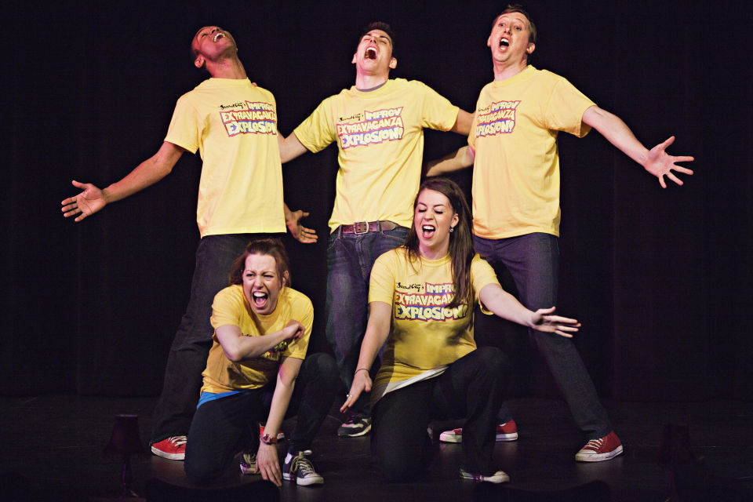
Types of Improv!
Shortform and Longform
Shortform improv is made of short scenes around a predetermined structure or game that are driven by audience involvement.
Longform improv is a whole show of short scenes with related characters, stories, or themes.

Slide 16
Where did Improv come from?
Improv draws from the theatrical traditions of
Commedia Dell’arte *
Clowning
Ideal of “Living in the moment”

Slide 17
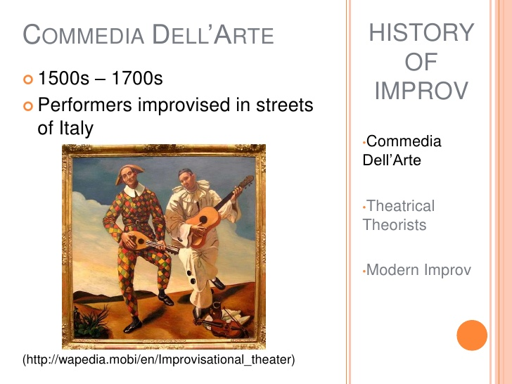

Slide 18
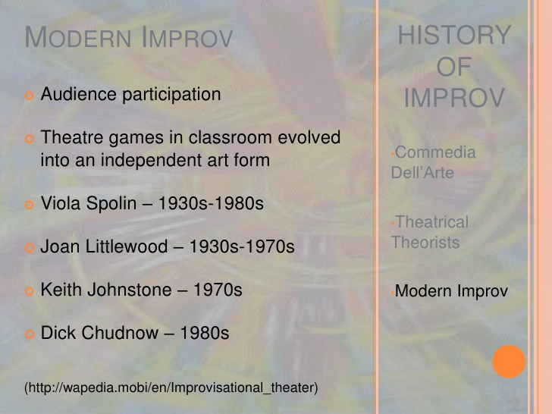

Slide 19
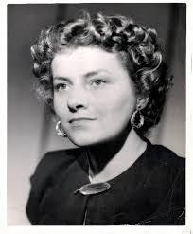
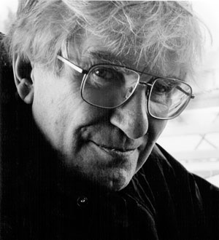
Who helped it grow into art?
However, improv as we know it today mainly comes from teachers Viola Spolin and Keith Johnstone, who transferred their theatre games from the classroom to the public stage.

Slide 20


Slide 21

Where did it get famous?
The Second City
The Second City is an improv theatre located in Chicago, Illinois.
The theatre was founded in December 1959 by a group of actors.
The Second City training center began in the 1980s, as the demand for classes in all forms of comedy increased.

Slide 22
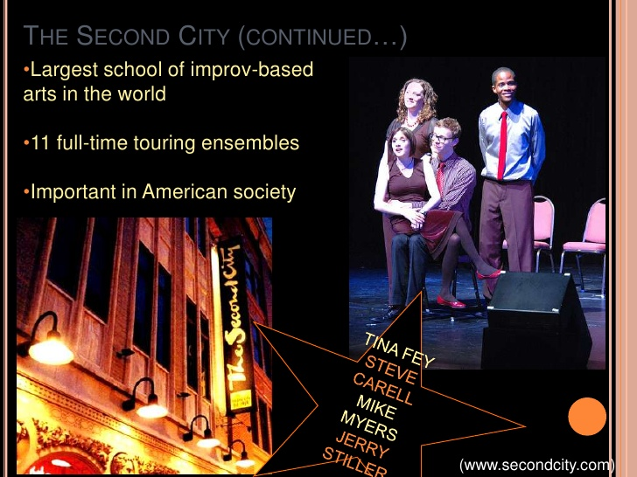

Slide 23
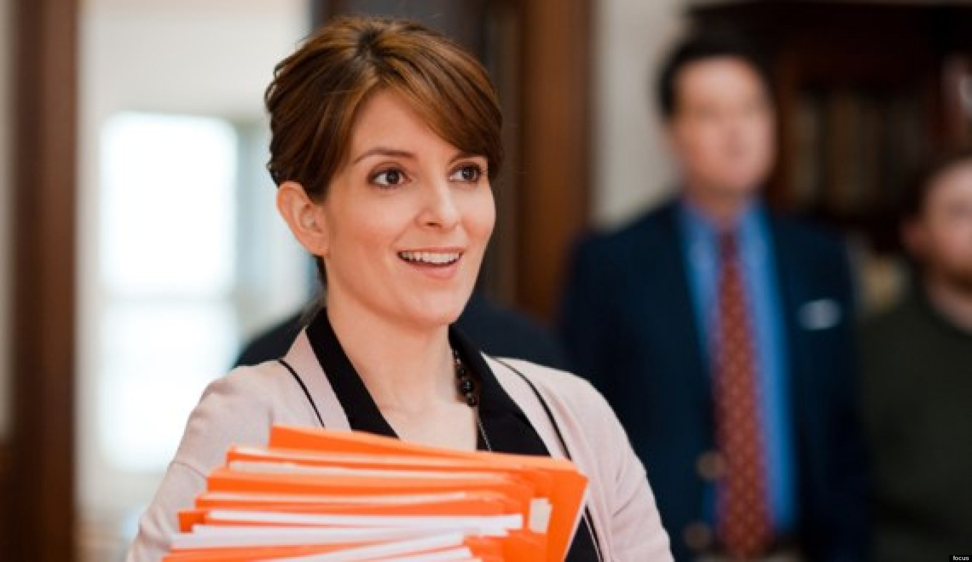


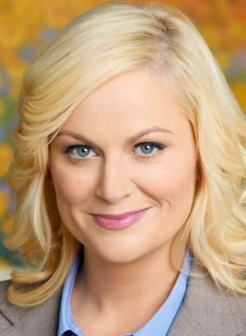

Famous Second City Actors
Tina Fey
Steve Carrell
Mike Meyers
Amy Poehler
Bill Murray

Slide 24
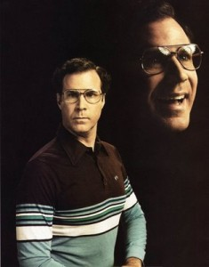

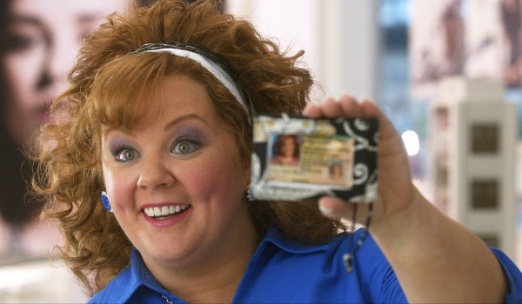
The Groundlings
The Groundlings are an improv troupe based out of Los Angeles, CA. The group has been active since it was founded in 1974.
The Groundlings School of Improvisation was founded in 1979, teaching improv, sketch comedy, and comedy writing.

Slide 25
The Second City
Besides the Chicago location, the Second City has outposts in Hollywood and Toronto, as well as a touring group.
Here are some great examples of Second City Sketches:
    Dr. Know-It-All
Ricardo Montalban School of Fine Acting
Perma-Laque Hair Spray
https://www.youtube.com/watch?v=M9SLIUbdZgk

Slide 26
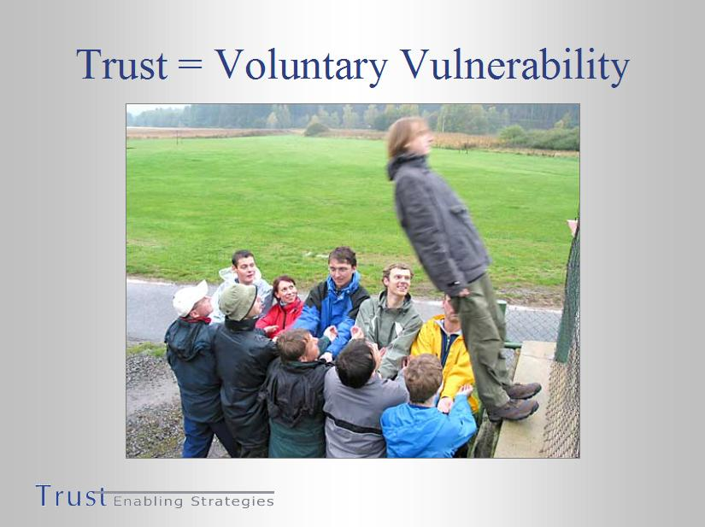
Trust and Vulnerability
Class Discussion
What does it mean to be truly vulnerable?
How can we use this as an acting tool?

Slide 27
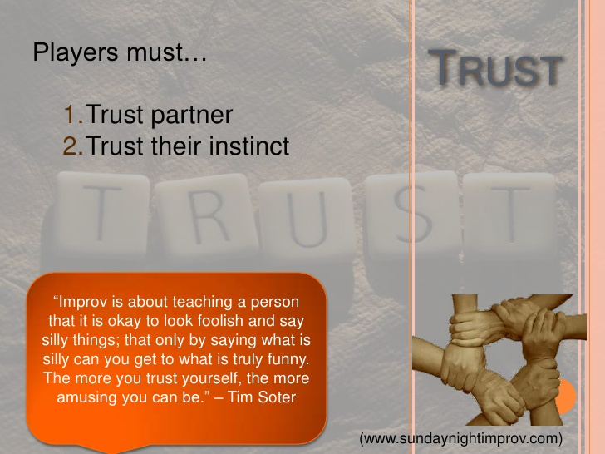

Slide 28
Vulnerability

Slide 29
Vulnerability Circle
Stand in a circle in the performance space
Listen to he directions given by the instructor.
What did you guys feel during this activity?
Was it difficult, yes or no? Why?
Was everyone giving the same, or did you come across people who were giving more than others?

Slide 30
DO NOW, DO NOW, DO NOW
Complete the
Improv Worksheet (5-8)
being handed out.
http://www.youtube.com/watch?v=YZtN8_xrd9o
http://www.youtube.com/watch?v=oCdkV8MOcDQ

Slide 31
Spontaneity
Coming from a natural impulse or tendency without effort or premeditation
Natural, unconstrained, unplanned

Slide 32
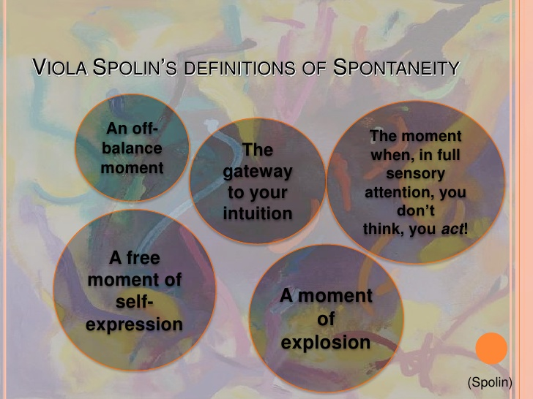

Slide 33

DING!
What does it mean to be spontaneous?
Write down an example of when you or someone you know has been acting upon a moment of spontaneity.

Slide 34
Let’s Improv!

Slide 35
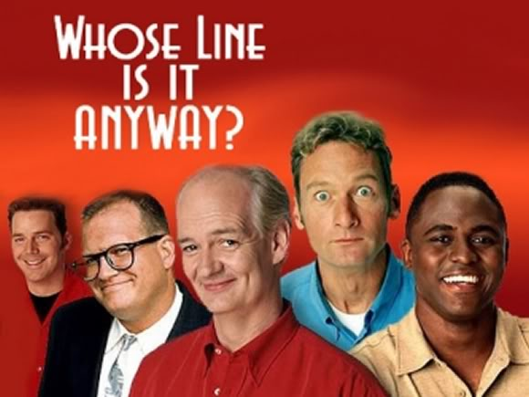
Shortform Improv Games
EMOTION SCULPTURES!
Chose a partner and
listen to Director
Guidance.

Slide 36
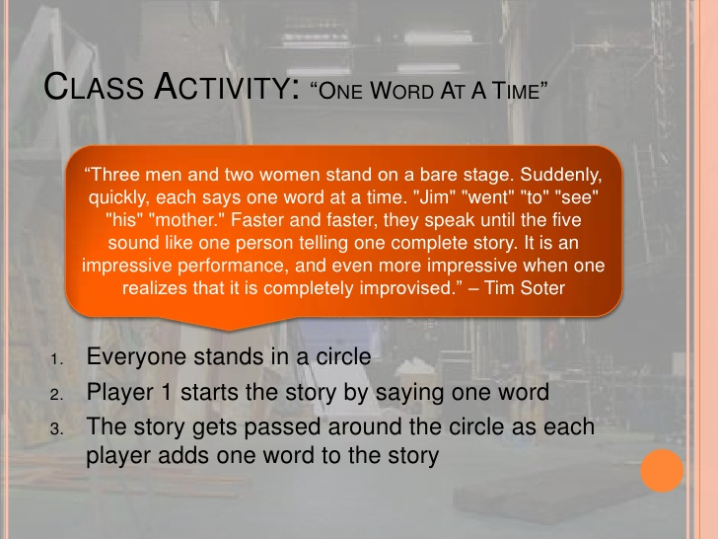

Slide 37
YES, AND!

Slide 38
Bibbity Bibbity Bop
Godzilla
Hula Hula
Haunted House
Pachyderm
Kung Fu
Bunny
Point at someone in the circle and says “bibbity bibbity bop” as fast as she can.
The person being pointed at must say “bop” before she gets to the end of her phrase.
If the teacher points to a student and only says “bop”, then the student must stay quiet.

Slide 39
Shortform Improv Games
EMOTION SCULPTURES!
Chose a partner and
listen to Director
Guidance.

Slide 40
Shortform Improv Games
Party Quirks
Questions Only!
Film, TV & Theater Styles
Hollywood Director
Weird Newscasters

Slide 41
Shortform Improv Games
Press Conference
Moving People
90 Second Alphabet
Fashion Models

Slide 42
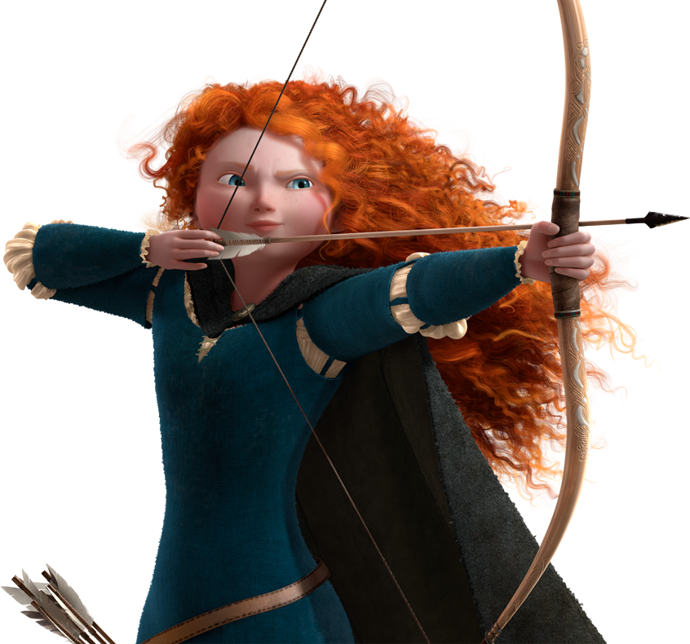
Film & TV Styles
Action
Suspense
Cartoon
Animal Planet
Science Fiction/Fantasy
Game Show
Musical
Broadway
Comedy
Western
News Report
Mystery
Horror
Romance
Super Hero
http://www.youtube.com/watch?v=8xvOpUZn4gY
http://www.youtube.com/watch?v=QqpmQEufUVY

Slide 43
Re-Imagining Fairy Tales Project
Choose your favorite fairy tale.
Brainstorm ways in which you can “modernize” this fairy tale using the same characters, setting and situations.
Complete the WORKSHEET

Slide 44

DO NOW, DO NOW, DO NOW
Watch & Write
Answer these Questions:
What made it interesting to watch?
What did you notice about their bodies, commitment, pantomime skills, creativity?
Why do you think they were so successful with their improv?

