Slide 1
Drama 5-7: Blocking & Stage Pictures
Behavior: Students will develop their blocking and stage picture skill set.
Conditions: Students will use Stage Blocking Worksheet / Teacher guided games to develop understanding.
Criteria: After analysis and activity, at least half the class with achieve at least a 3 on their Theater performance rubric.

Slide 2
1. What relationships do you see this this picture? 2. What types of characters do you see this this picture? 3. What in the picture helps you draw those conclusions?

Slide 3
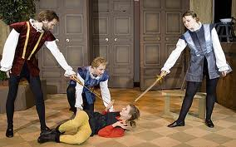
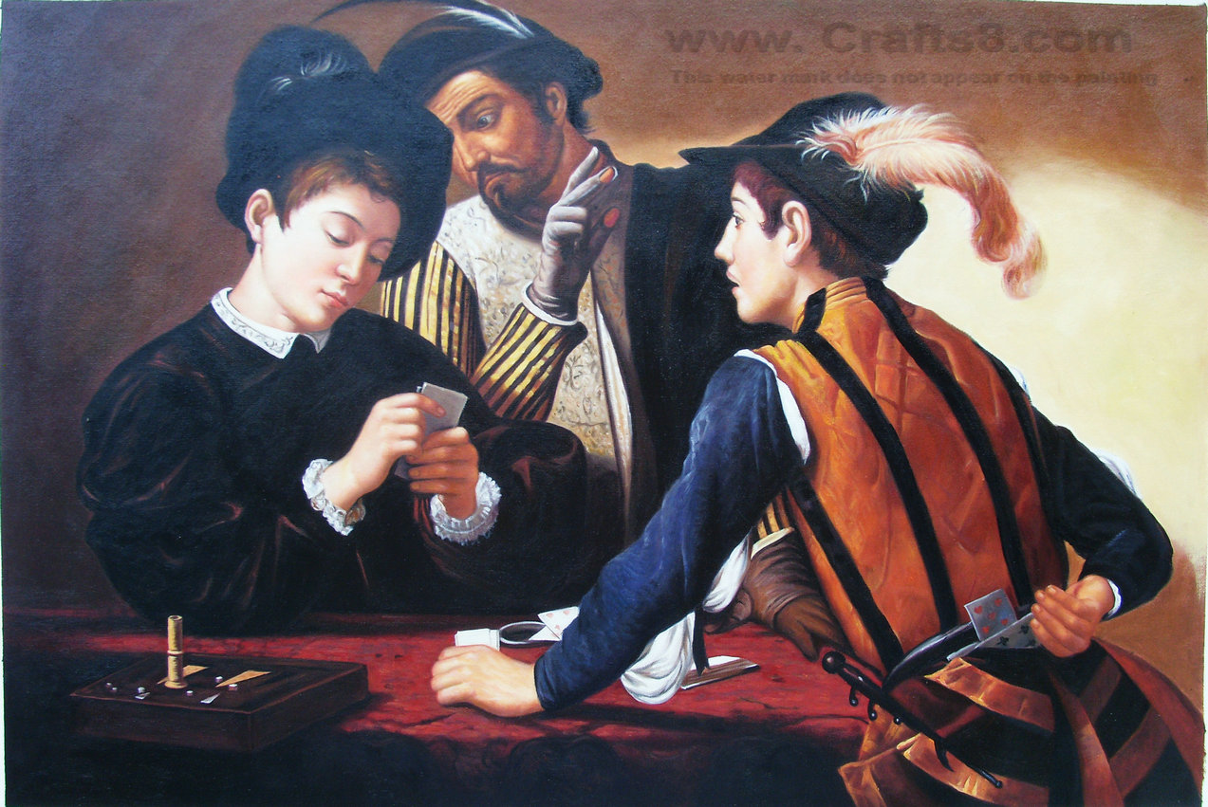
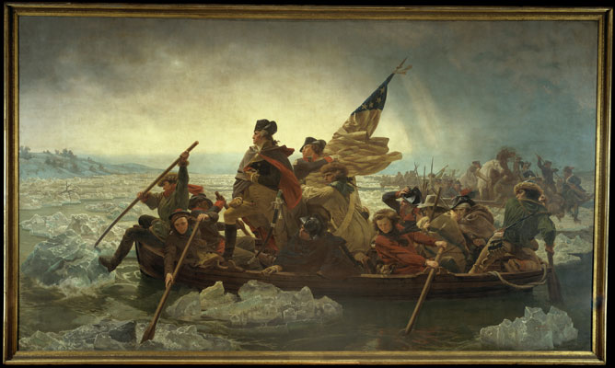
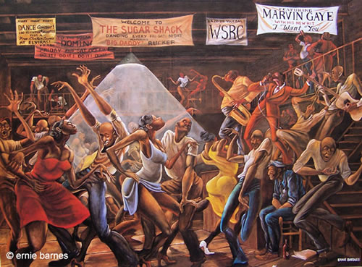
Group 4
Group 2
Group 1
Group 3

Slide 4
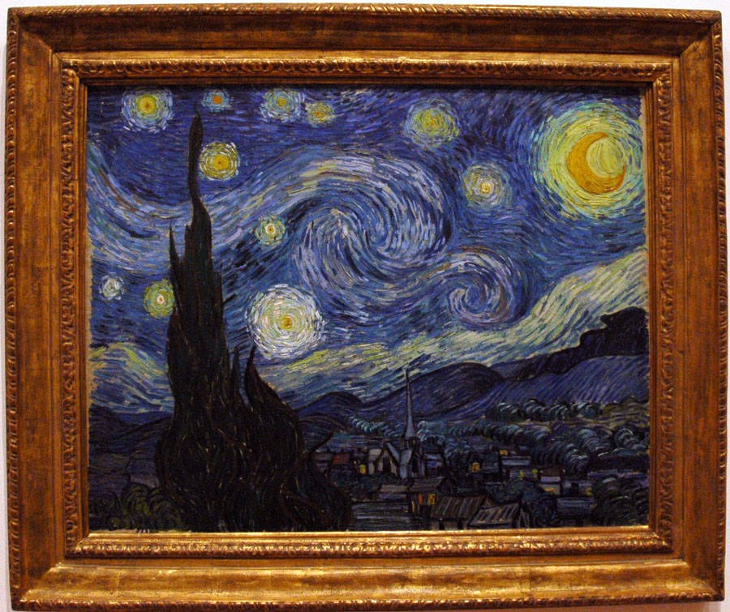
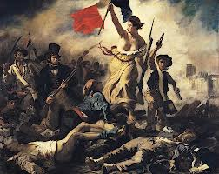
Let’s share our ideas! How does looking and analyzing a picture help us in theater? Why do we create Stage Pictures in theater?
STAGE PICTURE CHANGE-UPS
How does changing position (blocking) change our stage picture?
What do you notice happening that stands out?

Slide 5
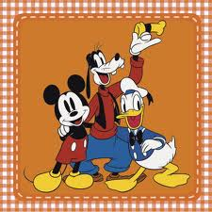
Block your Disney Scene!
Choose a person on your team to be . . .
Director: Chooses blocking and sets people on stage.
Blocking Manager: Writes down blocking in script line by line, character by character.
Producer: Presents blocking information and questions to class.
Why was the blocking effective, not effective?
Did the blocking support the action of the scene/emotions of characters?

Slide 6
Recreating Photos & Pictures
Create a story behind the picture and recreate the picture in order to incorporate their decisions as a group.
Each group performs the new picture for the class, and the class discusses what they saw.
Discuss with the class what worked better in the second pose than the first, and why…. How can you use blocking and stage pictures to tell your story better?

Slide 7
If working with Mr. Seidel
Blocking on stage
If working without Mr. Seidel
Create your Blocking our Scene Worksheet
Get a piece of paper, copy the format and answer the questions.

Slide 8
Name:____________________________________________________________Date:__________________
Blocking Our Scene
Characters:
Title of scene:
Instructions: Answer each question below as best you can, BE AS DETAILED AS POSSIBLE.
1) What is the relationship between your characters?
2) What are 3 ways to block your scene that can help show your relationships?
1)
2)
3)

