Slide 1
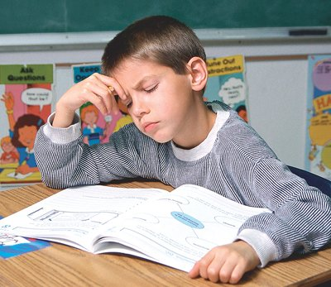
Reading Disabilities
Lisa Liberty, Ph.D.
October 20, 2014

Slide 2
“Current difficulties in reading largely originate from rising demands for literacy, not from declining absolute levels of literacy.”
Report of the National Research Council
Notes:
An enormous proportion of young citizens cannot read well enough to adequately function or to expand their knowledge about the world. The National Research Council reports that current reading difficulties in reading largely originate from rising demands for literacy, not from declining absolute levels of literacy. Other researchers suggest that teachers are still using instructional strategies that lack enough research evidence or that have the pseudonym scientifically based reading research.

Slide 3

Agenda
Introduction
Discuss the Story of “Nathan”
Acquire understanding of Learning Disabilities
Discuss prevention/intervention framework
Understand specific reading skills that are necessary to access general education curriculum.
Learn various teaching strategies for students with learning disabilities.
Small group activity: Case Study

Slide 4
Who is Nathan?
How does Nathan struggle with learning to read?
Describe the types of evaluations used to identify Nathan with a LD?
What types of supports and services does Nathan require in a general education setting?

Slide 5

What is a Learning Disability?

Slide 6
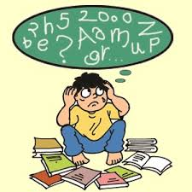
Federal Definition of Specific Learning Disability
“A disorder in one or more of the basic psychological processes involved in understanding or in using language, spoken or written, which may manifest itself in the imperfect ability to:
  listen
  think
  speak
  read
  write
  perform mathematical calculations
Term includes:
  perceptual disabilities
  brain injury
  minimal brain dysfunction
  dyslexia
  developmental aphasia
  Term does not include a learning problem that is primarily the result of visual, hearing, motor disabilities, mental retardation, emotional disturbance, environmental, cultural, or economic disadvantage.

Slide 7

Basic Psychological Processes
Memory
  short and long term
  encoding
  storage
  retrieval
Auditory Perception
  recognize differences between sounds
  ability to make a complete word by blending the individual sounds
  identify words and sounds that have been presented in incomplete form
  ability to relate ideas, find relationships, make associations, and categorize information
Visual Perception
  identify dominant features in different objects and discriminate among a variety of objects
  recall the dominant features of a stimulus that is no longer present
Sequencing
Attention
  Time on task
  Focus
  Distractibility
  Selective attention
Organization
Social perception
Notes:
Short-term: storage of a limited amount of information (6 to 8 bits) for a limited amount of time
Long-term: memory of a longer duration
Working memory: ability of a student to hold a small amount of information in short-term memory while working with that information and integrating it with other information
Time on task: amount of time in which a student is engage in an activity
Focus of attention: focus on most relevant stimuli
Distractibility: cannot focus on anything
Selective attention: identify the important aspects of a stimulus and disregard all of the other stimuli in the environment
Encoding translating a sensor input into some representation form for storage
Retrieval: process of recovering an encoded representation of a stimulus from memory

Slide 8

Learning Disabilities
Arise from neurological differences in brain structure and function and affect a person’s ability to:
  receive information
  store information
  process information
  retrieve information
  communicate information
Result from insults to the developing brain before or during birth.
Result of postnatal events such as:
  traumatic injuries,
  severe nutritional deprivation
  exposure to poisonous substances (e.g., lead)

Slide 9

What We Know About LD
Higher reported incidence of LD among people living in poverty.
Learning disabilities are both real and permanent.
May individuals with LD suffer from low self-esteem, set low expectations for themselves, struggle with:
  underachievement
  underemployment
  have few friends
Appear to end up in trouble with the law.

Slide 10

Data on Students With LD
The largest category of students receiving special education services.
  2.4 million American public school students identified with LD under the Individuals with Disabilities Education Improvement Act (IDEIA)
  Forty-two percent of the 5.7 million school age children with all kinds of disabilities who receive special education services are served in this category.
Two-thirds of students identified with LD are male.
Black and Hispanic students are overrepresented in many states while white and Asian students are underrepresented in the LD category.

Slide 12
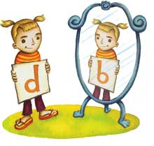
A Learning Disability is…
An unexpected, significant difficulty in academic achievement and related areas of learning and behavior for
  individuals who have not responded to high-quality instruction, and
  Individuals whom struggle which cannot be attributed to medical, educational, environmental or psychiatric causes.

Slide 13
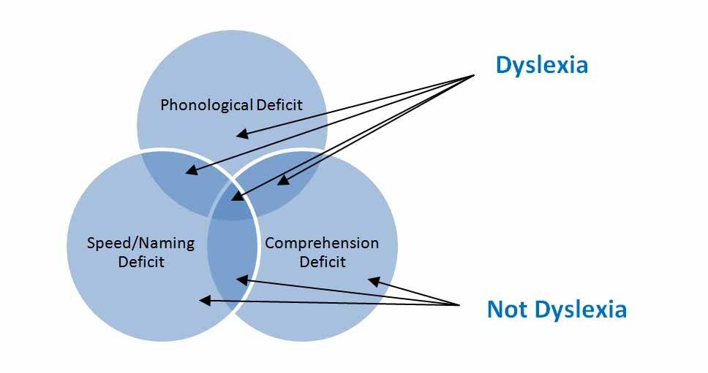
Academic Discrepancy in…
Oral expression
Listening comprehension
Written expression
Basic reading skills
Reading comprehension
Mathematical calculation
Mathematical reasoning

Slide 14

Reading Disabilities
85% of students with LD have significant difficulties in reading
Dyslexia

Slide 15
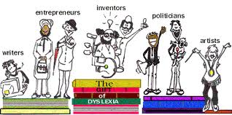
Dyslexia
Contrary to popular belief, dyslexia is not a problem of letter or word reversals (b/d, was/saw) or of letters, words, or sentences “dancing around” on the page.

Slide 16
Dyslexia
Simply put, dyslexia is a significant difficulty in reading, also known as a specific learning disability in reading.

Slide 17
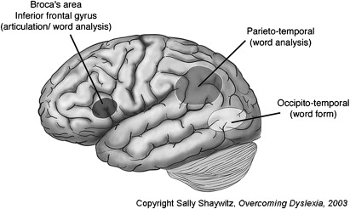
Dyslexia

Slide 18
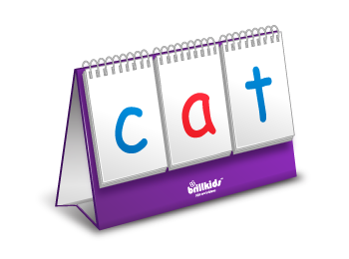
Dyslexia is…
A term associated with specific learning disabilities in reading.
  Difficulty with phonemic awareness
    The ability to notice, think about and work with individual sounds in words
  Difficulty with phonological processing
    Detecting and discriminating differences in phonemes or speech sounds
  Difficulties with word decoding, fluency, rate of reading, rhyming, spelling, vocabulary, comprehension, and written expression

Slide 19
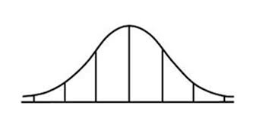
Like so many other things, Reading Achievement is also normally distributed in the population.
Percentile Ranks
50th
84th
16th
2nd
98th
70
85
100
115
130
Standard Scores

Slide 20
Discrepancy Definition
Standard Scores

Slide 21
Discrepancy Definition
Depending on the State can meet the definition for RD
Standard Score

Slide 22
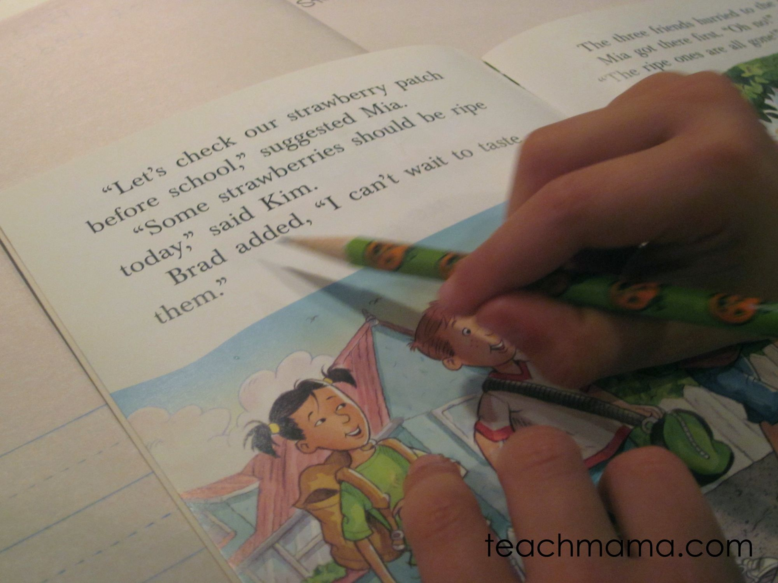
Assessment & Intervention Framework for Struggling Readers

Slide 23
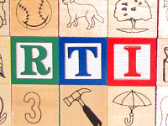
A Child with LD is Eligible if…
They do not achieve adequately for the their age or meet state-approved grade-level standards when:
  provided with learning experiences and instruction appropriate for the child’s age or state approved grade-level standards.
  the child does not respond to scientific, research-based intervention.

Slide 24
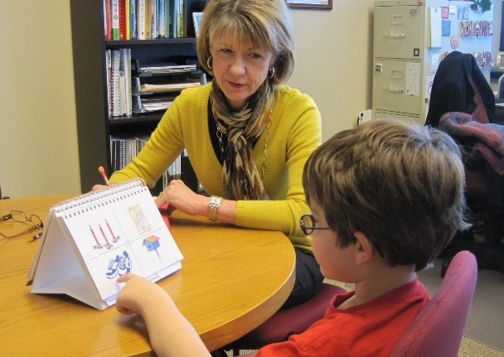
Problems Identifying Students with LD
IQ tests
Intelligence of students with LD may be underestimated
Failure to discriminate between groups of poor readers
Difficult to identify students in the early grades

Slide 25

Remediation, Intervention & Prevention
Remediation
  Correcting a deficiency
Intervention
  Altering an action
Prevention
  Process of preventing something from occurring

Slide 26
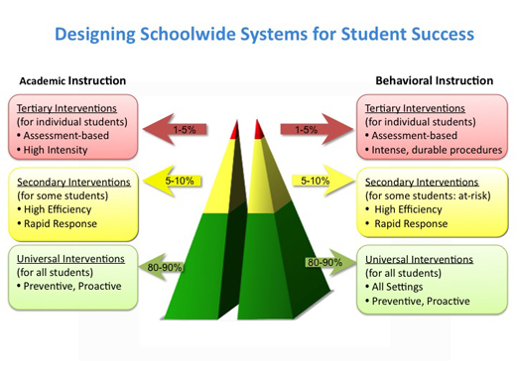
Prevention & Intervention Framework

Slide 27
Framework for Prevention and Intervention
Assess and Diagnose
Teach/Reteach
Reassess
Apply
Practice

Slide 28
Effective Intervention Components
Use clear objectives
Follow specific sequence for teaching
Inform the students of the importance of the strategy
Monitor performance
Encourage questions that require students to think about strategies and text
Encourage appropriate attributions
Teach for generalized use of the strategy

Slide 29
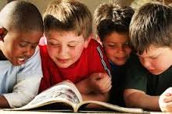
Basic Reading Skills

Slide 30

Children Must Be Able To…
Hear, identify, and manipulate the individual sounds in spoken words.
Understand the relationship between the letters of written language and the individual sounds of spoken language, and using these relationships to read and spell words.
Read connected text effortlessly, automatically, and accurately.
Understand and use words to acquire and convey meaning.

Slide 31

“The best predictor of reading difficulty in kindergarten or first grade is the inability to segment words and syllables into constituent sound units (phonemic awareness)”
(Lyon, 1995)

Slide 32
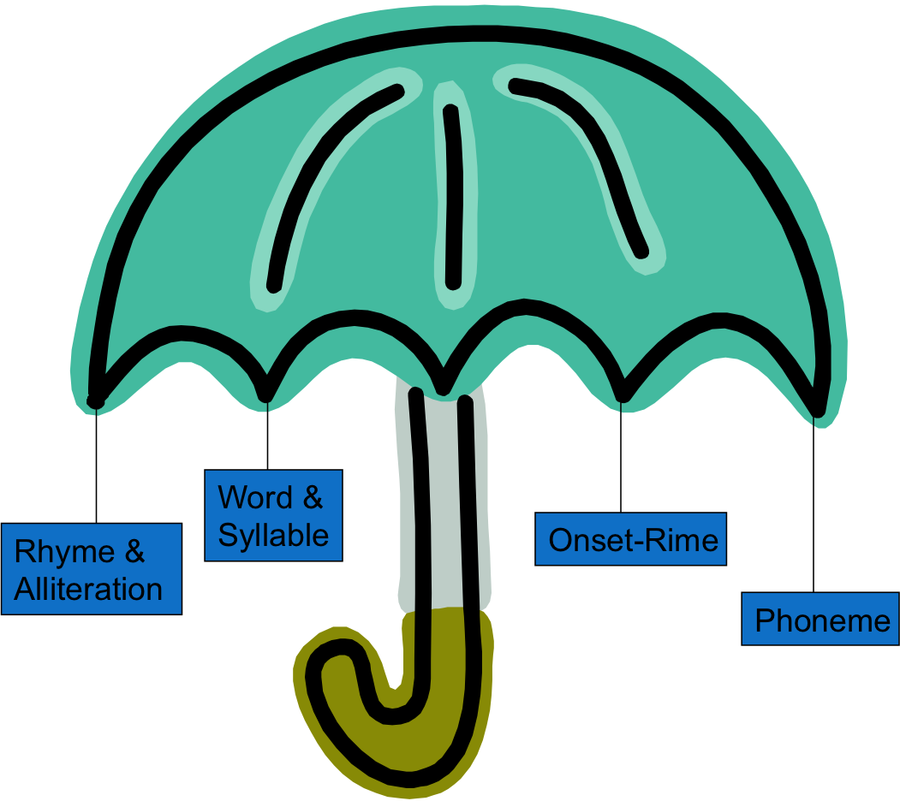
PHONOLOGICAL AWARENESS
The sensitivity or awareness of word structure in one’s own language.
This includes an awareness at the word, syllable and sound level.
Notes:
Phonological awareness is the ability to attend to the sounds of speech in language. It includes noticing similar sounds in words, appreciating rhymes and counting syllables.

Slide 33
Important fact about talent in the phonological language domain:
It is like most other talents in that it is distributed normally in the population

Slide 34
“Phonological talent” is normally distributed in the population
Percentile Ranks
50th
84th
16th
2nd
98th
70
85
100
115
130
Standard Scores

Slide 35
Fundamentally, these problems arise from an underlying weakness or lack of talent in phonological language processing.
A lack of talent in language processing that is not necessarily related to a person’s IQ.

Slide 36
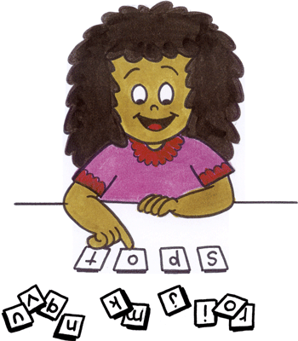
PHONEMIC AWARENESS
Understanding that words are made up of small reusable chunks of sound.
Awareness of the critical distinctive features of phonemes so that their identity, order, and number can be specified in words.
Awareness of way phonemes are co-articulated when they are blended.

Slide 37
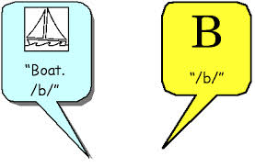
Phonemic Awareness is Difficult because:
There are 26 letters in the English language and there are approximately 40 sounds in the English language.
Sounds are represented in 250 different spellings.
(e.g., /f/ as in ph, f, gh, ff)
It requires readers to notice how letters represent sounds.

Slide 38
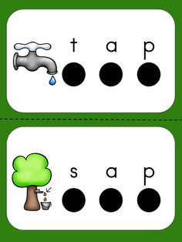
Children Lacking PA Skills Cannot…
Group words with similar and dissimilar sounds
(e.g., mat, mug, sun)
Blend and split syllables
(e.g., f oot)
Blend sounds into words
(e.g., m_a_n)
Segment a word as a sequence of sounds
(e.g., fish is made up of three phonemes
/f/, /i/, /sh/)
Detect and manipulate sounds within words
(e.g., change r in run to s for sun)

Slide 39
What is Reading Fluency?
Accurate reading at a conversational rate with appropriate prosody.
(Hudson, Lane, & Pullen, 2005)
Decoding and comprehending text at the same time.
(Samuels, 2006)

Slide 40

Why is Fluency Important?
Because it provides a bridge between word recognition and comprehension

Slide 41
Current Hypothesis About the Persistent Fluency Gap
Children who struggle initially miss out on the hundreds of thousands of opportunities to learn words.
By 3rd or 4th grade, their sight word vocabulary is very small compared to good readers their own age.
Even if they get intense intervention and become accurate readers, they are still very dysfluent because their peers are also learning new sight words.
They are trying to catch up to a moving target.
    Torgesen, Rashotte, & Alexander, 2001
Notes:
Slow development of the “sight vocabulary” necessary for fluent reading arising from …
limited exposure to text and
lack of strategies to reliably identify words in text.

Slide 42
Projected growth in “sight vocabulary” of normal readers and disabled children before and after remediation
Average
Grade in School

Slide 43
But what if the intervention happened earlier?
Size of “sight vocabulary”
Grade in School

Slide 44

Teaching Reading to Students with Reading Difficulties

Slide 45
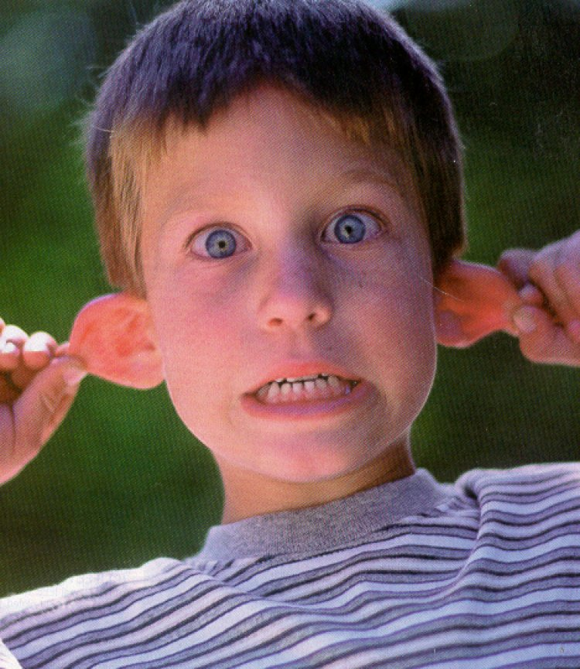
Phonological Awareness Instruction
Most should happen in kindergarten and first grade
Small-group instruction is best
More PA instruction is not necessarily better
Focus on 1 or 2 skills rather than many at once
Connection between skills practice and meaningful application is essential
PA instruction that includes letters is most effective
Notes:
Best in small groups of 3 to 4 students
15-20 minutes, 2-3 times a week is a good guide
Remember to teach children to apply the PA skills of segmenting and blending into spelling and reading as soon as possible

Slide 46
Phonological Awareness Instruction
in the Reading Curriculum
In Kindergarten
carefully sequenced from easy to more difficult tasks
regular part of the curriculum -- 15-20 min. a day
involve both analytic and synthetic activities
emphasis on oral language activities initially, but work with letters can be integrated as soon as initial levels of phonemic awareness are reached
instruction should be fun for teachers and students

Slide 47

Sequence of Activities for Kindergarten
Listening Games
sharpen ability to listen selectively to sounds
Rhyming Activities
use rhyme to introduce the idea of listening for the sounds in words
Sentences and Words
awareness that sentences are made of words
Syllables
segment and blend syllables

Slide 48
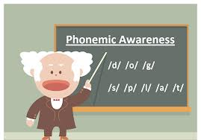
Goals for Instruction in Phonemic Awareness
Help children…
acquire an understanding that words are composed of small, reusable segments of sound.
become aware of the distinctive features of phonemes.
blend phonemes together to form words.
use their phonemic awareness in direct support of becoming better readers and spellers.

Slide 49

Phonemic Awareness Instruction
Sound Blending
  Blend the sounds of these letters to make the word
  /mmmmmaaannn/
Segmenting
  What sounds do you hear in this word?
Manipulating letter-sound correspondences in words
  What word would you have if you change the /n/ in /nap/?

Slide 50
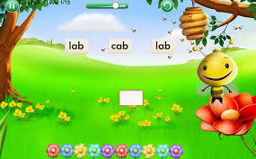
Sound Blending Instruction
When first learning to blend, use examples with continuous sounds, because sounds can be stretched and held.
  Example: ”Listen, my lion puppet likes to talk in a broken way. When he says /mmm/ - /ooo/ - /mmm/ he means mom.”
  Non-example: “Listen, my lion puppet likes to talk in a broken way. When he says /b/ - /e/ - /d/ he means bed.”

Slide 51
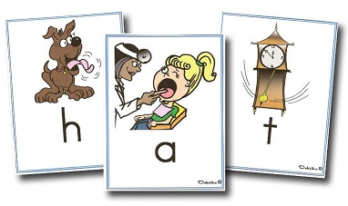
Suggested Word Patterns for Blending
When children are first learning the task, use short words in teaching and practice examples. Use pictures when possible.
  Example: Put down 3 pictures of CVC words and say: “My lion puppet wants one of these pictures. Listen to hear which picture he wants, /sss/ - /uuu/ - /nnn/. Which picture?”
  Non-example: “…/p/ - /e/ - /n/ - /c/ - /i/ - /l/. Which picture?” (This is a more advanced model that should be used later.)

Slide 52
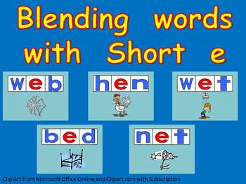
Suggested Word Patterns for Blending
As children become successful during initial learning, remove scaffolds by using progressively more difficult examples.
As children become successful with more difficult examples, use fewer scaffolds, such as pictures.
  Example: Move from syllable or onset-rime blending to blending with all sounds in a word and remove pictures. “Listen, /s/ - /t/ - /o/ - /p/. Which picture?” “Listen, /s/ - /t/ - /o/ - /p/. What word?”
  Non-example: Provide instruction and practice at only the easiest levels with all the scaffolds.

Slide 53
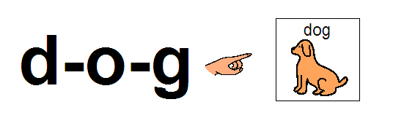
Consideration for Selecting Materials to Teach Blending
When children are first learning the task, use materials that reduce memory load and to represent sounds.
  Example: Use pictures to help children remember the words and to focus their attention. Use a 3-square strip or blocks to represent sounds in a word.
  Non-example: Provide only verbal activities.

Slide 54
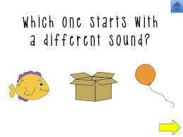
Teaching Phonemic Segmentation
Concurrently teach letter-sound correspondences for the sounds children will be segmenting in words.
  Example:
    Letter sound /s/ and words sun and sit. Put down letter cards for familiar letter-sounds. Then, have children place pictures by the letter that begins with the same sound as the picture.
  Non-example:
    Use letter-sounds that have not been taught when teaching first sound in pictures for phoneme isolation activities.

Slide 55
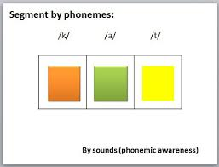
Teaching Phonemic Segmentation
Make the connections between sounds in words and sounds of letters.
  Example: After children can segment the first sound, have them use letter tiles to represent the sounds.
  Non-example: Letters in mastered phonologic activities are not used. Explicit connections between alphabetic and phonologic activities are not made.

Slide 56
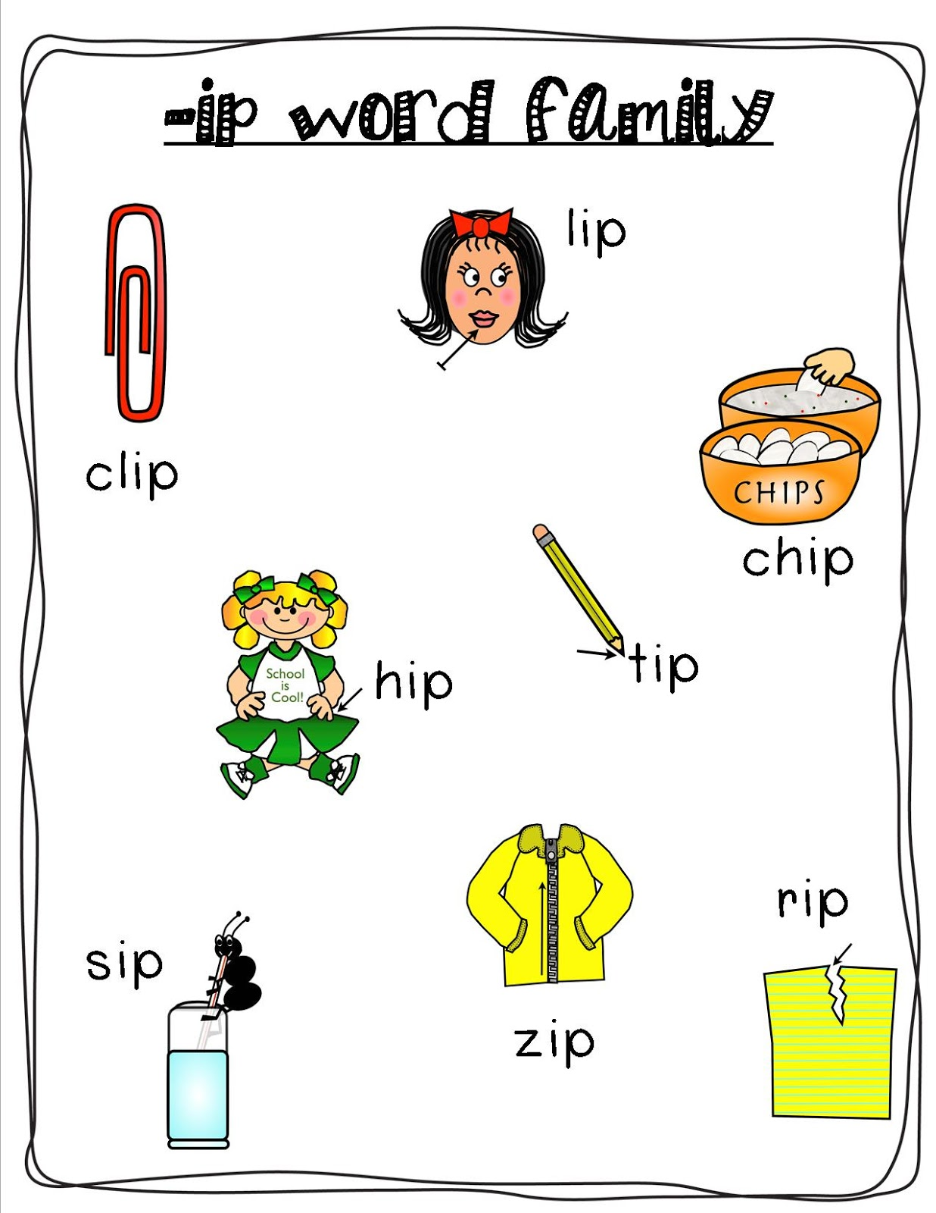
Extensions of Teaching Segmenting
By the end of grades 1 and 2, students should be able to demonstrate the following skills:
  Substituting: “Nap. What word do we get when we change the /n/ to /c/?” (as in rhyming or word family practice).
  Deleting: “Flake. What word do we get when we take away /l/ from flake?”
  Adding: “Mile. What word do we get when we add /s/ to the front of mile?”

Slide 57

Teaching Letter-Sound Correspondence
Example: Teacher points to letter m on the board.
  “The sound of this letter is /mmmmmm/.”
  Tell me the sound of this letter
Conspicuous Strategies:
  Teacher actions should make the task explicit
  Use consistent and brief wording

Slide 58
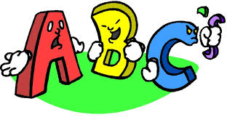
Suggested Sequence for Introducing Letters
a m t s i f d r o g l h u c b n k v e w j p y
T L M F D I N A R H G B x q z J E Q

Slide 59
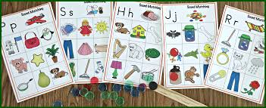
Considerations for Selecting Materials
Letter-Sounds
  Separate auditory and/or visually similar letters (e.g., e/i, d/b)
  Introduce some continuous sounds early (e.g., /m/, /s/)
  Teach the sounds of letters that can be used to build many words (e.g., m, s, a, t).
  Introduce lower case letters first unless upper case letters are similar in configuration (e.g., similar: S, s, U, u, W, w; Dissimilar: R, r, T, t, F, f)

Slide 60
Features of Letter-Sound Correspondence Instruction to Consider…
Are easily confused sounds separated over several lessons? (d/b/p, e/i, m/n)?
Are letter-sounds that occur in a large number of words introduced early in the sequence?
Is the rate of letter-sound correspondence introduction manageable for the learner but adequate to allow multiple words to be made within 2-3 weeks?
Does the sequence include a few short vowels early to allow students to build words?
Does the sequence begin with several continuous sounds.

Slide 61

Teaching Irregular Words
Do Not introduce irregular words until students can reliably decode words at a rate of one letter-sound per second.
Initially, introduce one word every several lessons, then one each second or third lesson
Irregular words require systematic review. New words should appear in word-list exercises for several days, then appear in either or both passages and word-list exercises. .
Notes:
Show Format for introducing and reviewing irregular words, pg. 183 Kameenui

Slide 62
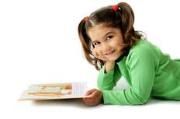
Reading Fluency
ACCURACY
Correctly decoding unknown words
Recognizing familiar or high-frequency words

Slide 63
Reading Fluency
AUTOMATICITY
Letter level-quick and effortless identification of letter sounds
Word level-quick and effortless word recognition or decoding
Text level-fluid pace in reading connected text

Slide 64
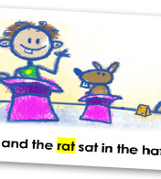
Reading Fluency
PROSODY
Making reading sound natural, or like spoken language
Using appropriate inflection
Using appropriate expression
Pausing appropriately at phrase boundaries

Slide 65
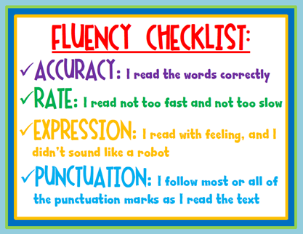
Reading Fluency Instruction
Repeated Readings
Once students can accurately decode CVC and VC word types, these words should be introduced in short, highly controlled passages.
Do NOT assume that learners will automatically transfer from reading words correctly in lists to reading words in passages.

Slide 66
Repeated Reading
Combine with word learning.
Select passages that include “targeted.” vocabulary and/or passages at the student’s independent level.
Monitor progress and provide feedback to students.
Support reading with modeling and feedback from teacher or peers.
Involve students in progress monitoring of fluency goals.
As students improve, increase passage difficulty
From the COI PD module by Murray, Wexler, Vaughn, Roberts, Klingler, Tackett, & Kosanovich (2008)

Slide 67
Repeated Reading
Repeated reading is very flexible.
Can be integrated into many different reading programs.
Can do repeated readings of text read aloud by teacher.
In order to better meet the individual needs of your students, you can…
  Vary instructional settings
  Vary purposes
  Vary materials
  Vary modalities
From Blum & Koskinen (1991)

Slide 68
The Bottom Line
As with any skill that requires an individual to coordinate a series of small actions to create a unified process, it is practice that allows the learner to develop expertise.
(Kuhn & Stahl, 2002)

Slide 69

Language Components & Skills
Form
  Syntax
Content
  Semantics
    Vocabulary
    Word categories
    Word relationships
    Synonyms
    Antonyms
Use
  Pragmatics
    Knowledge and ability to use language functionally in social or interactive situations.
Notes:
Form: rules by which a given communications system is governed; the “how” of language
Content: the meaning component; the “what” of language
Use: reason, purpose: the “why” of language
Integration of the three components is referred to as Language Competence
Problems in language may be result of
Simple delay in development of language competence
Disruption in one or more of the three components
Failure to integrate the three components functionally

Slide 70
Difficulties with the Form of Language
Lack the length or syntactic complexity.
(e.g., “Where Daddy go?”)
Problems comprehending sentences that express relationship between direct or indirect objects.
Difficulty with wh questions.

Slide 71
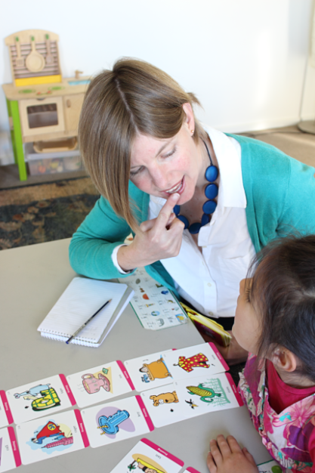
Difficulties with Semantics
Limited vocabulary especially in adjectives, adverbs, prepositions, or pronouns
Longer response time in selecting vocabulary words
Fail to perceive subtle changes in word meaning
  incomplete understanding and misinterpretations
Problems with figurative language

Slide 72
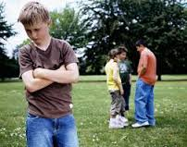
Difficulties with the Use of Language
Problems understanding indirect requests
(e.g., may say yes when asked “Must you play the piano?”)
May enter conversations in a socially unacceptable fashion or fail to take turns talking
Difficulty staying on topic

Slide 73
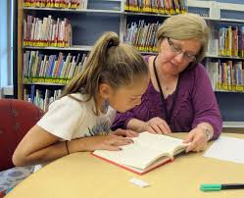
Strategies for Increasing Language Comprehension
Establish eye contact and cue student to listen.
Ask student to repeat directions.
Classroom arrangement to reduce distractions.
Use familiar vocabulary when presenting new concept.
Present new concept in as many modalities.
Teach memory strategies (e.g., visual imagery, clustering and grouping information).

Slide 74
Strategies for Increasing Language Production
React to the content of student’s message, then correct syntax error.
Teach language in various settings.
Act as a good language model, have students imitate what they hear.
Comment or elaborate on students’ ideas to provide more information.
Use storytelling, role playing, or charades to improve verbal expression.
Use structured language programs that provide adequate practice.

Slide 75

Children in Kindergarten Should Learn…
Letter-Sound Correspondence
  Identify the letter when someone produces the corresponding sound.
  Say the most common sound associated with individual letters.
Decoding
  Blend the sounds of individual letters to read one-syllable, short-vowel, decodable words (e.g., sun; map).
Sight-Word Reading
  Recognize some words by sight including a few common, high-frequency words (e.g., a, the, I , my, you, of, is are).

Slide 76

Children in First Grade Should Learn …
Letter-Sounds and Letter-Combinations
  Produce the sounds associated with all individual letters fluently (e.g., 1 letter-sound per second).
  Produce the sounds that correspond to frequently used letter combinations (e.g., sh, er, th).
Decoding
  Decode words with consonant blends (e.g., mask, slip, play).
  Decode words with letter combinations accurately (diagraphs: fish, bath, chin; common letter combinations: book, farm, toy).
  Use knowledge of individual letter-sound correspondences and letter-combinations to read regular monosyllabic words fluently (e.g., mask, skip, play, fish, them, chin) at a rate of one word every 1 to 1.5 seconds).
  Read words with common words parts (e.g., ing, all, ike).
Sight Word Reading
  Increases knowledge of common sight words and reads them automatically (e.g., have, would, there, said)

Slide 77
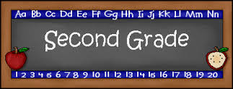
Children in Second Grade Should Learn…
Letter-Sound Knowledge
  How to produce the sounds that correspond to frequently used dipthongs (e.g., ou, oy, and digraphs sh, th, ea).
Decoding and Word Recognition
  How to uses knowledge of advanced phonic elements (e.g., digraphs and dipthongs), special vowel spelling, and word endings to recognize words.
  To read compound words, contractions, possessives, and words with inflectional endings.
  To use word context (semantics: Does it make sense?) and order in the sentence (syntax: Does it sound right?)
  To Rear multisyllabic words (2-3 syllables) using syllabication and word structure (e.g., base/root word, prefixes, and suffixes) in word recognition.
Sight Word Reading
  Increases the number words read accurately and quickly.

Slide 78

Activity
Directions:
In small groups, read the case study.
Determine whether the child has a Reading Disability.
Identify the specific skills the child needs supplemental instruction in and how that will support access to general education curriculum.
Explain how you would teach the skills using the prevention/intervention framework.

Slide 79
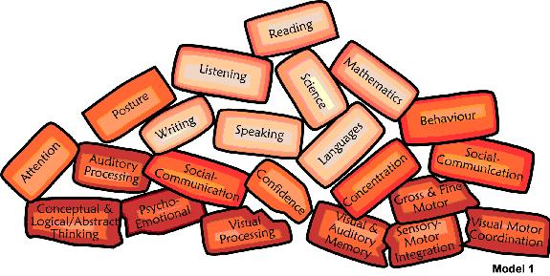
Teaching Tips for Managing, Attention, Memory, & Language Difficulties

Slide 80

Teaching Tips for Attention
Use numerous cues to keep students on task… “point to number three on your paper.”
Visually monitor student’s eye contact with the assigned task.
Keep external distractions to a minimum.
Draw shades if necessary.
Use background music in your class to cover the routine classroom noise.
Use a colored marker to code the instructions on each worksheet for student.
Use a self-monitoring sheet for paying attention.

Slide 81

Teaching Tips for Improving Memory
Get a clear, meaningful encoding of the material to be learned.
Have a purposeful intention to learn.
Organize and elaborate information to make connections.
Overlearning (providing added practice) aids retention.
Use mnemonic and other memory devices.

Slide 82
Mnemonic Keyword Method
Help! A PARASITE
Notes:
Keyword that interacts with one another. For example, to teach that a parasite is an organism that lives off a host, keyword for parasite is “pear, because it sounds like parasite and is easily pictured, and keyword for host is ghost because it sounds like host

Slide 83
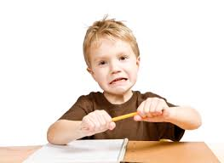
Metacognitive Instructional Approaches

Slide 84
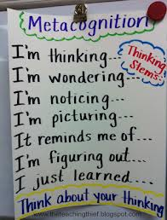
Metacognitive Activities
Planning the cognitive task
Self-instruction to complete the task
Self-monitoring

Slide 85
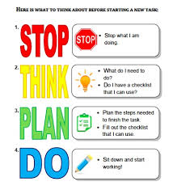
Learning Strategies
Use of acronyms to structure inner language
  RIDER – reading comprehension
    Read, Imagine, Describe, Evaluate, Repeat
  SLANT – note-taking
    Sit-up, lean forward, activate your thinking, name key information, track the talker
  SCORER – take multiple-choice tests
    Schedule your time, clue word use, omit difficult questions, read carefully, estimate your answers, review your work

Slide 86
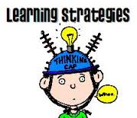
Learning Strategies Cont.
PLEASE – improve paragraph writing
  Pick a topic, list ideas, evaluate list, activate the paragraph with topic sentence, supply supporting sentences, end with concluding sentence, evaluate work
SCORE A – preparing research paper
  Select topic, create categories for the information about topic, obtain sources, read and take notes, evenly organize the information, apply the process writing steps
FAST – social problem solving
  Freeze and think about the problem, alternatives to be generated, solution, try it

Slide 87
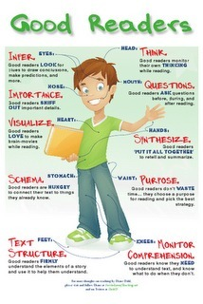
Self-Monitoring
Use of visual prompt
Audio prompt
Data check sheets
Letter-by-letter proofing – monitor and correct spelling

Slide 88

Resource
Florida Center for Reading Research
http://www.fcrr.org/for-educators/sca.asp

Slide 89
Great site to get your own reading pages of connected text made:
Intervention Central is very helpful in the areas of CBM (Curriculum Based Measurement), RTI (Response to Intervention), PBIS (Positive Behavioral Support), reading, writing, and math.
The name of the tool is OKAPI! The Internet Application for Creating Curriculum-Based Assessment Reading Probes and can be found at http://www.jimwrightonline.com/htmdocs/tools/okapi/okapi_28Aug06_original_pg.php

Slide 90
Thank You!!!!
Contact Information:
Lisa Liberty
973.761.9093
lisa.liberty@shu.edu

